Slide 1
Supporting the supporters
EGI solutions for federated e-infrastructures and research infrastructures
Małgorzata Krakowian, Gergely Sipos
EGI.eu User Support

Slide 2
Outline
EGI – Enabling infrastructures for research
Open Science Commons vision
From potential to active user communities
  EGI Engagement Strategy
From bright ideas to robust infrastructures
  Virtual Teams

Slide 3
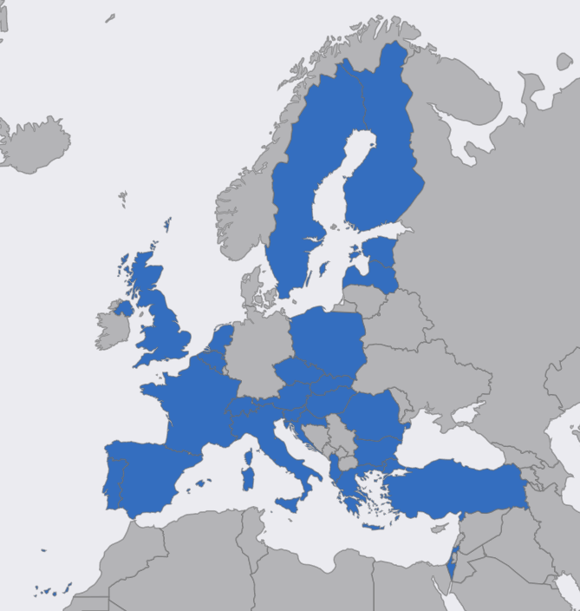
EGI
25 participants
  National Grid Initiatives
  EIROs
Federation
  IT services and resources
e-Infrastructure
  Computers, Data, Applications
  Clouds, clusters, HTC,….
  and beyond!!
Sustainability
  Sustainable operation
  Project-driven innovation
    EGI-Engage, AARC, INDIGO, etc.
EGI.eu in Amsterdam
Notes:
E-Infrastructures are geographically distributed computing resources and data storage facilities linked by high-performance networks. They allow scientists to share information securely, analyse data efficiently and collaborate with colleagues worldwide. They are an essential part of modern scientific research and a driver for economic growth.
The European Grid Infrastructure (EGI) was established in 2010 building on over a decade of investment by national governments and the European Commission. EGI is a European-wide federation of national computing and data storage resources. Its aim is to support cutting-edge research, innovation and knowledge transfer in Europe. EGI federates resources from various resource centres, mainly from research insitututes and universities. These centres provide computer clusters, storage servers, applications and human support services for secure access and sharing. EGI provides these services to European researchers and their international collaborators.
EGI is coordinated by EGI.eu, a not-for-profit foundation based in Amsterdam and owned by EGI’s participants, the National Grid Infrastructures (NGIs).

Slide 4
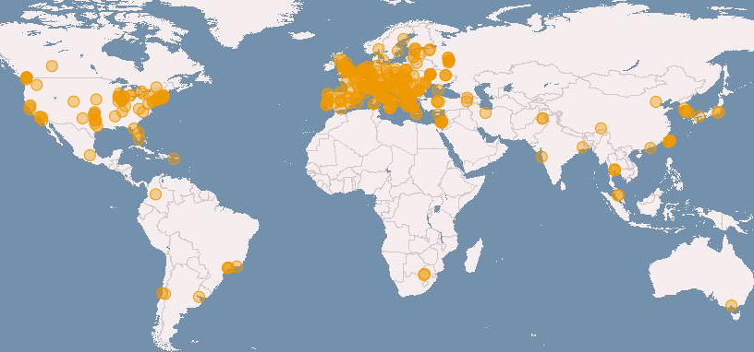








Enabling e-infrastructures for science
SLAs
OLAs
Distributed, federated storage and compute facilities
HTC and Cloud compute platforms
Virtual Research Environments
> 200 user research projects
350 resource centres in 40 countries
500,000 logical CPU cores
>290 PB disk, 180 PB tape
> 99.6% reliability
.
.
.

Slide 5
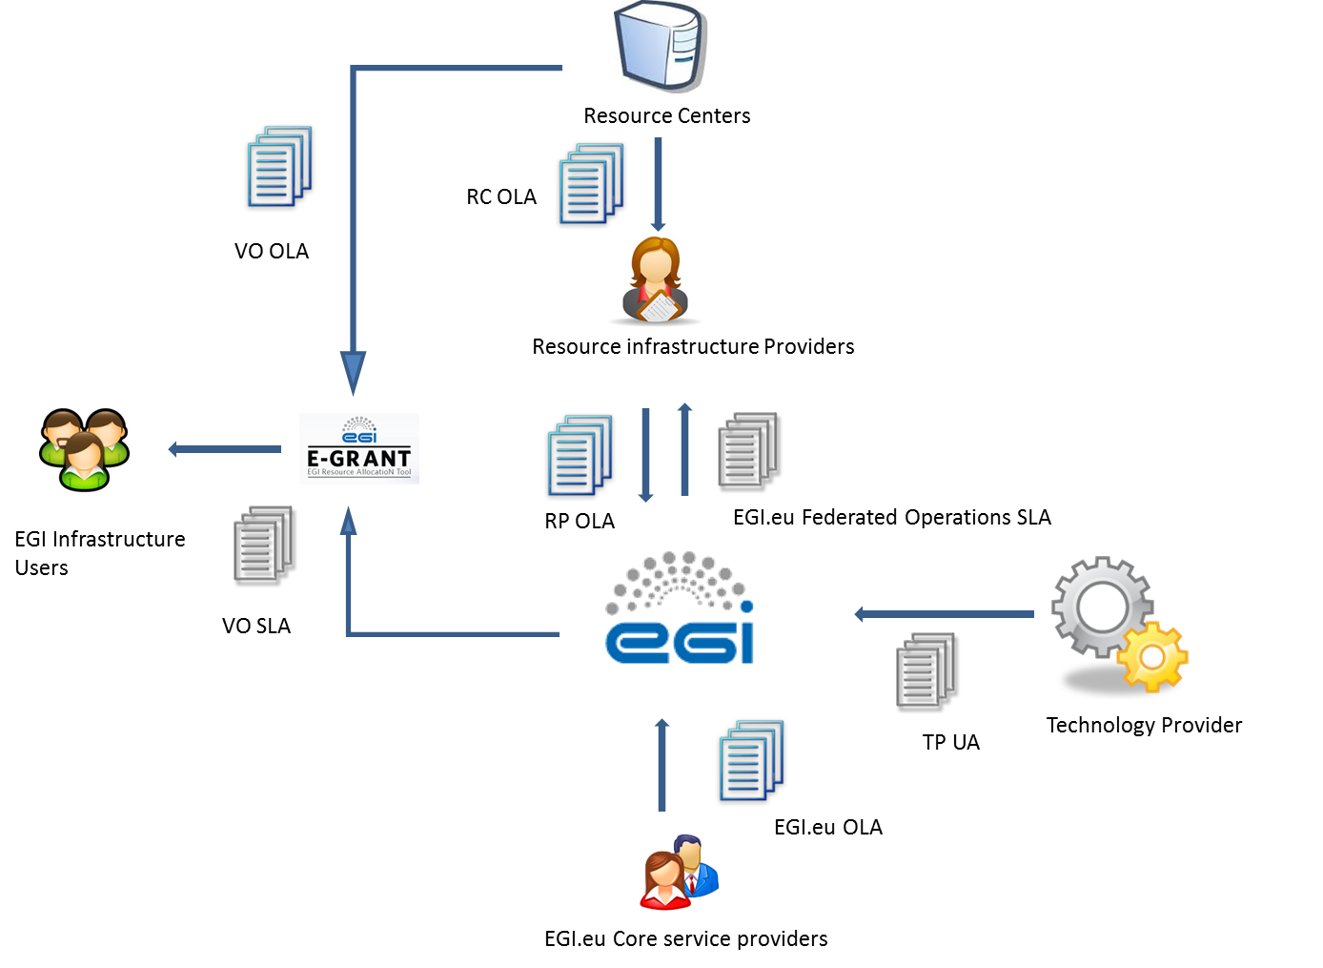
EGI agreements framework

Slide 6

Open Science Commons vision
Researchers from all disciplines have easy, integrated and open access to the advanced digital services, scientific instruments, data, knowledge and expertise they need to collaborate to achieve excellence in science, research and innovation.
www.opensciencecommons.org
Scientific Instruments
Data Commons
E-infrastr. Commons
Knowledge Commons
Projects and partnerships:
E-infras, Res. Infras, Funding agencies
Notes:
OSC is an approach to sharing and governing advanced digital services, scientific instruments, data, knowledge and expertise that enables researchers to collaborate more easily and be more productive.
Issues to tackle:
Lack and/or incomplete roadmaps for research- and e-Infrastructures
Fragmented solutions and policies for access to data and knowledge.
Insufficient cooperation between public and private sector
Lack of national and European organization between all stakeholders
Many providers without a single market

Slide 7




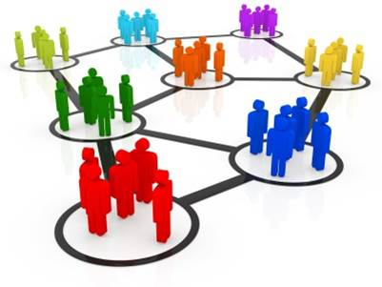



EGI Solutions
High-Throughput Data Analysis
Federated Operations
Community Driven Innovation
Federated Cloud
Individual Researchers
Research Communities
Resource Centres
SMEs and industry
http://www.egi.eu/solutions

Slide 8
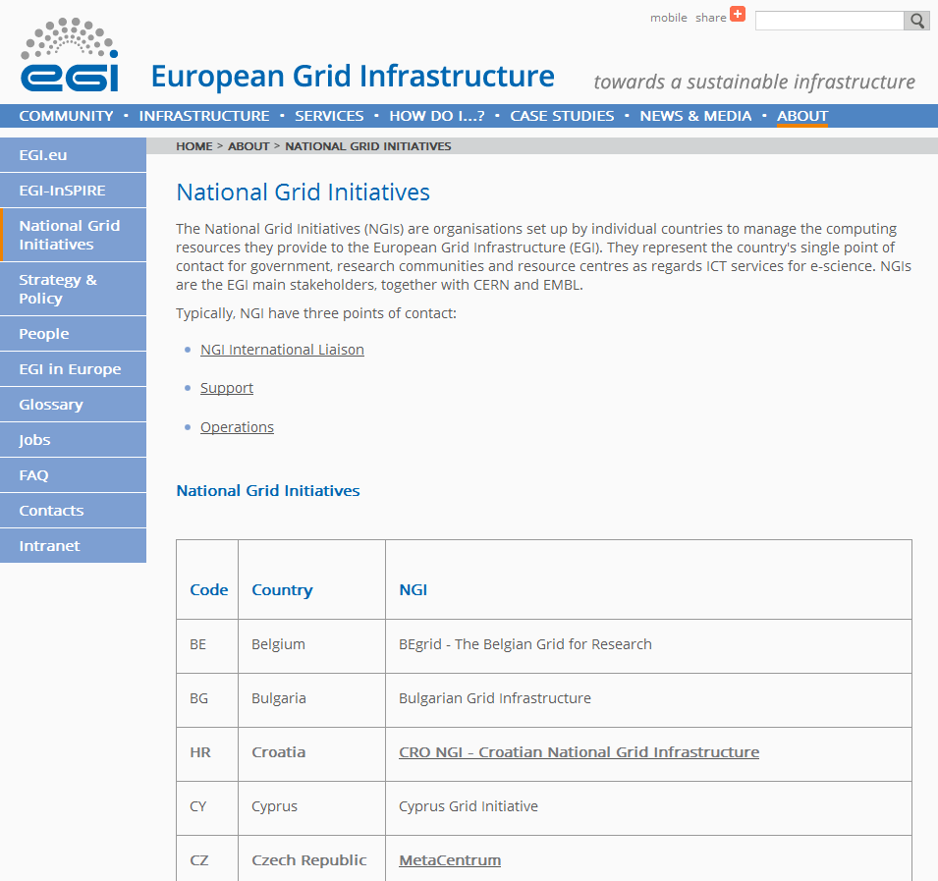
Partnerships: Our partners in the NGIs
Named contacts for:
  User support
  Infrastructure Operation
  International liaison (~outreach to new comms.)

Slide 9
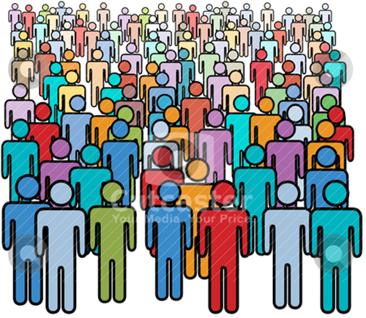











Reaching out to new communities:
Target groups and specific needs
Use
services
Individual researchers
Scientific applications
Create
services
Capacity (HTC/cloud)
App. frameworks;
Tech. assistance
Research collaborations
Collab. & communic. services
Operate
services
Research infrastructures
Operation tools, dashboards
...
Research infrastructure clusters

Slide 10
Scalable outreach and support
User Support Teams
of the
National Grid Infrastructures
Individual researchers
Use
services
Scientific applications
Create
services
Capacity (HTC/cloud)
App. frameworks;
Tech. assistance
Research collaborations
EGI.eu
User Community Support Team
&
Technology/community-specific
Support teams
Collab. & communic. services
Operate
services
Research infrastructures
Operation tools, dashboards
...
Research infrastructure clusters

Slide 11
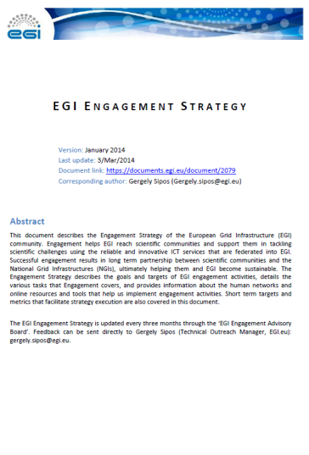
Doing it: Engagement
Engagement strategy
  http://go.egi.eu/engagementstrategy
  To define what, why, who, how, when
  Monthly Engagement meetings
Coordination, implementation and support from EGI-Engage
EGI.eu teams
Coordination
NGI International Liaisons
EGI-Engage
Technologies
Champions
Heavy User Communities
(User Community Board)
Support
Distributed Competence Centre
Collaborating projects

Slide 12
From needs to solutions
Technical
engagement
Outreach
Implementation
Events and communication
Consultancy and support
Virtual Teams and
Competence Centres
User
communities
Outcome
Awareness and interest in EGI
Existing solutions
Joint activity plan
Excellent science
Success cases, tools, champions, etc.

Slide 13
Requirement gathering and tracking
Channels for Operation requirements
EGI Engagement Board
Technology providers
VOs
Channels for
User & community requirements
Requirements Tracker
Virtual Teams
VRCs
projects
NGIs
CCs
EGI members
External
Helpdesks
(EGI, NGIs, projects,...)
The EGI Community
Submit your requirements
Browse requirements
Offer solution to requirements:
http://go.egi.eu/requirements

Slide 14
Virtual Team project life-cycle
Request
Email request to vtc@egi.eu
Run
Integrated NGI & EGI.eu staff
Not just the NILs, but through them!
Report
To the EGI community
events, newsletters, Webinars, etc.
Proposal written following the recommended structure
Evaluated by EGI-Engage Activity Management Board

Slide 15
Current Virtual Teams
PROJECT | START DATE
Promoting Desktop Grids | Nov 2013
Support for genome analysis and protein folding | Apr2014
Platform for the long-tail of science | Oct 2014
Integrating life science reference datasets into EGI | Dec 2014

Slide 16
Support for genome analysis and protein folding VT
Goals/Tasks:
1. Identify and integrate relevant tools from the domain
2. Raise awareness about EGI tools and support
Life sciences
Genomics
Members:
2 EGI Champions
3 NGIs
3 scientific communities
Proteomics
Structural Biology
Bioinformatics
Achievements:
1. Integration of 4 tool from the domain with EGI
READemption (DE), Trufa (ES), Chipster (FI), RSTAT (FR)
2. Promotion of 17 applications/tools
    1 webinar and 3 face-to-face events
    Reaching approx. 100 scientists

Slide 17

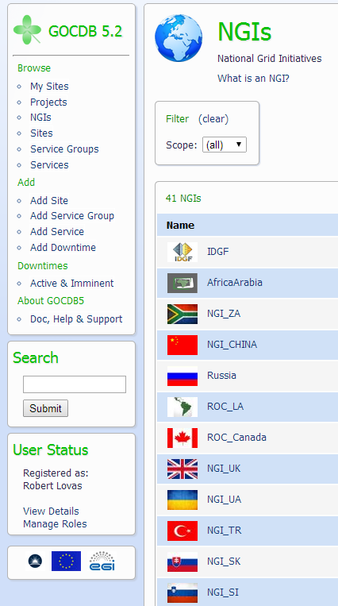
Promoting Desktop Grids VT
Goals/Tasks:
  Promote DG technology and support uptake
Members:
  Albania, Bulgaria, Hungary (leader), Italy, Malaysia,
  Netherlands, Serbia, Spain, Taiwan, UK, Ukraine
Achievements:
  Integrating 5000 cores from 65 countries
    New European DG Operations Centre
  New applications from
    Structural biology
    Biodiversity science
    Mathematics (prime numbers; linear algebra)

Slide 18
Platform for the long tail VT
Long tail: individual researchers and small research teams
National solutions exist in several countries. But we need
  More consistent support across all countries with simplified access
  Facilitation of interactions between researchers and NGIs
  Lower cost of operation
Long tail platform
  User registration portal and science gateways
  Dedicated resources in a Global VO (grid and cloud)
  New security mechanism: User-specific robot proxies
Development started in October 2014
  https://wiki.egi.eu/wiki/Long-tail_of_science_pilot
  Release at EGI Conference 2015 (May 18-22)

Slide 19
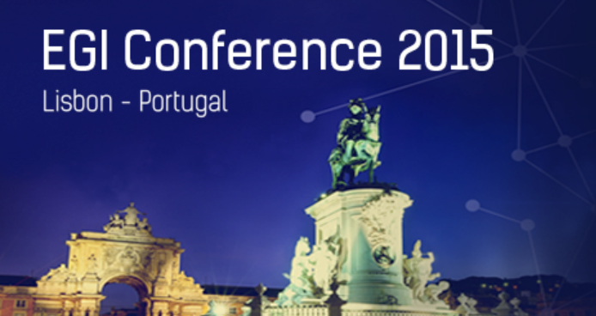
EGI Conference 18-22 May 2015
Engaging the Research Community towards an Open Science Commons
http://conf2015.egi.eu/
Registration open until 11 May 2015

