Slide 1









Activities and Experiences from the UK Software
Sustainability Institute
Neil Chue Hong, N.ChueHong@software.ac.uk
User Support Workshop @ NeIC 2015, Espoo, 6th May 2015 (@npch)
Where indicated
slides licensed under
Supported by
Project funding
from
www.software.ac.uk

Slide 2


















UK Research Computing Ecosystem
People
Computing
Software
Communities
…
Data
Network/Collaboration
Instruments

Slide 3
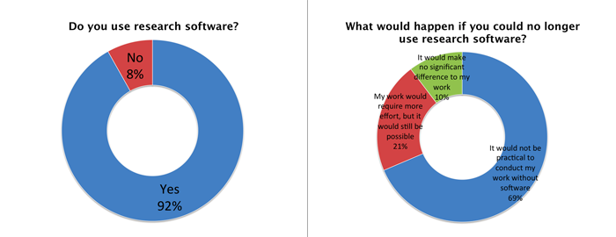
Software isn’t special, it’s mainstream
92%
69%
Survey of researchers from 15 Russell Group unis conducted by SSI between Aug- Oct 2014.
406 respondents covering representative range of funders, discipline and seniority.
http://www.software.ac.uk/blog/2014-12-04-its-impossible-conduct-research-without-software-say-7-out-10-uk-researchers
Notes:
Variation in use with seniority of respondent
The use of research software varies little with seniority.
It’s difficult to measure seniority, so we simply asked how many years the respondents had worked in research. There isn’t a great deal of variation: the percentage of use varies by 12% with those having worked in research for 6-10 years reporting the most use (98%) and those having worked for more than 20 years in research reporting the lowest use (86%).
The first two categories – those have worked less than a year, and those that have worked for 1-5 years – report 91-92% use. Use peaks in the next ten years and then drops in the 15-20 year and more than 20 year groups.
There are different ways to explain this variation. Unfortunately, they cannot be confirmed by our data. It seems likely that low- and mid-seniority researchers are the workhorses of research and do the most generation of results – and hence are most likely to use software. Once a researcher gets more senior, there is the tendency to perform more management duties which makes them less likely to use research software.

Slide 4
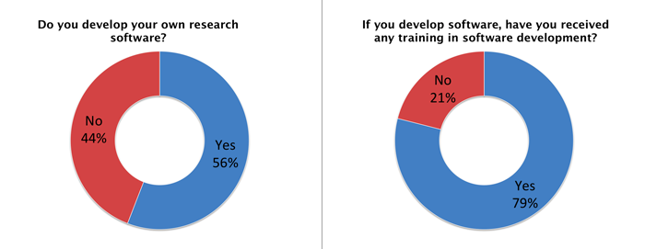
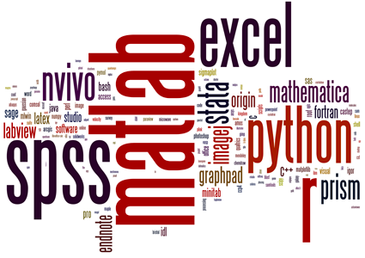
And everyone’s a developer
56%
Survey of researchers from 15 Russell Group unis conducted by SSI between Aug- Oct 2014.
406 respondents covering representative range of funders, discipline and seniority.
http://www.software.ac.uk/blog/2014-12-04-its-impossible-conduct-research-without-software-say-7-out-10-uk-researchers
Notes:
What software are people using?
A lot of different software is being used: we recorded 566 different packages - some of them have only one user within our surveyed community, some with many. The most popular packages are Matlab (20% of respondents use it), R (16%), SPSS (15%), then Excel (12%). To show the use diagrammatically, we created the Wordle shown at the top of the page.
A lot of researchers are developing their own software – even though they lack training
It’s not just proprietary software, many researchers are developing their own code: 56% of them. This is great news, because the real power of software lies in developing it to allow you to do more in less time and make new research possible.
Many people in the research community are developing their own software, is the development in safe hands?
55% of respondents have received some training in software development (15% self taught and 40% had received some form of taught course). Worryingly, 21% of respondents who develop their own software had no training in software development. That’s one in five researchers developing software blind.
Software that is developed without adequate training is unlikely to be reliable. Researchers are, by their very nature, intelligent people who learn new skills quickly, but there are many subtle pitfalls in developing good code (that is, code that won’t later lead to paper retractions). And that’s only the case for reliability! We want defensible results, which requires a whole swathe of skills related to producing reproducible code, and we want to protect the research investment, which requires yet more skills for writing reusable software.

Slide 5
So what’s the issue?
30%
Of UK research investment has been spent on research which relies on software
71%
Of UK researchers have had no formal software development training
77%
Of PIs had not included costs for software development in bids
… and then there are gender related issues
4%
Of jobs advertised in UK universities were software related
Survey of researchers from 15 Russell Group unis conducted by SSI between Aug - Oct 2014.
406 respondents covering representative range of funders, discipline and seniority.
Analysis of data from 49,650 grant titles and abstracts published on Gateway to Research
covering 2010-2014. Analysis of job adverts posted to jobs.ac.uk in 1H2014.
Notes:
Software development costs are not being included in bids
Many researchers believe that including costs for developing software in a proposal will weaken it. We’ve had steer from the Research Councils that this is not the case - something we’re trying to persuade the research community to believe. But we may have our work cut out.
When we asked the people who are responsible for writing proposals whether they had included costs for software development, 22% said that they had, 57% said they had not, and 20% said that they had not even though they knew software development would make up part of the bid! (Note that rounding errors make these figures sum to 99%.)
Differences in software use with respect to gender
Women made up 36% of respondents to the survey, men made up 62% and the remainder went to “other”, “prefer not to say” or no response (the gender question was not mandatory).
There is no difference in the percentage of women and men who use research software: 92% each. This is heartening news!
Differences in software development with respect to gender
Although there is no difference in the use of research software, there is a huge difference when it comes to developing software: 70% of men develop their own research software, whereas only 30% of women do.
This preponderance of men in development is reflected, as one would expect, in training. Only 39% of women had received software development training of some form, relative to 63% of men who have received training.

Slide 6
The “long tail” is the mainstream but most e-Infrastructure support is focussed on the tip

Slide 7


The Software Sustainability Institute
A national facility for cultivating better, more sustainable, research software to enable world-
class research
Software reaches boundaries in its
development cycle that prevent
improvement, growth and adoption
Providing the expertise and services
needed to negotiate to the next stage
Developing the policy and tools to
support the community developing and
using research software
Supported by EPSRC
Grant EP/H043160/1
Notes:
The Software Sustainability Institute can help with: software reviews and refactoring, collaborations to develop your project, guidance and best practice
on software development, project management, community building, publicity and more…
Drawing on pool of specialists to drive the continued improvement and impact of research software developed by and for researchers
Providing services for research
software users and developers
Developing research community
interactions and capacity
Promoting research software
best practice and capability

Slide 8
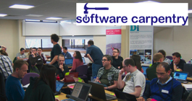

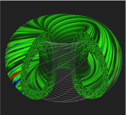
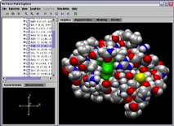
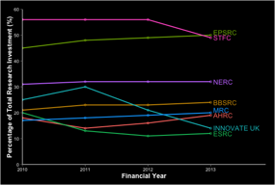
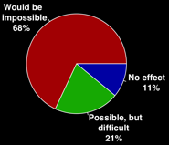
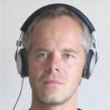
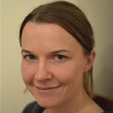
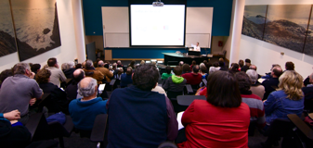
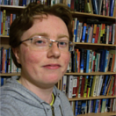
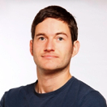
Software
Training
Helping the community to develop software that meets the needs of reliable, reproducible, and reusable research
Delivering essential software skills to researchers via CDTs, institutions & doctoral schools
Outreach
Exploiting our platform to enable engagement, delivery & uptake
Collecting evidence
on the community’s software use & sharing with stakeholders
Bringing together
the right people to understand and address topical issues
Policy
Community

Slide 9

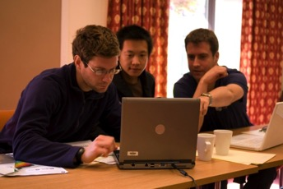
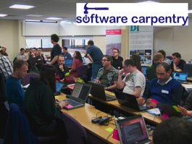
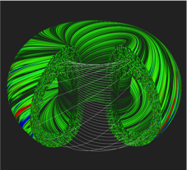
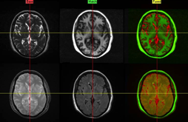
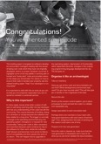
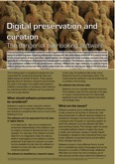
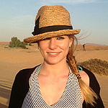
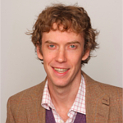
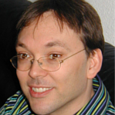
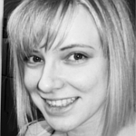
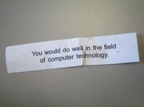

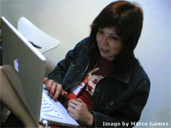
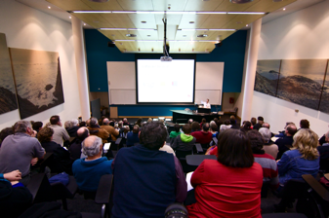
Software
Training
Advice
Courses
35+ UK SWC
workshops
1000+ learners
Consultancy
50+ projects
130+ evaluations
4 surgeries
Guides
Outreach
80+ guides
50,000 readers
Website & blog
150+ contributed articles
20,000 unique visitors per month
3,000 Twitter followers
Research
740 researchers
50,000 grants
analysed
Campaigns
Workshops
Fellowship
61 domain
ambassadors
300+ RSEs engaged
2100 signatures
13 issues highlighted
Policy
Community
20+ workshops organised

Slide 10
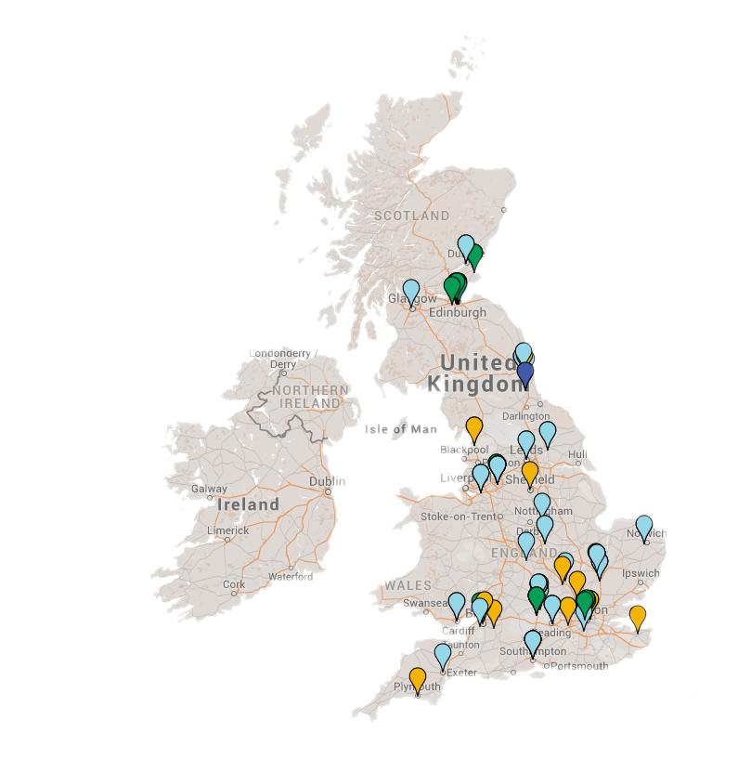
We go out to the communities, not make them come to us
Fellows
British Antarctic Survey
Cardiff Metropolitan University
Diamond Light Source
King's College London (2)
Imperial College London (2)
Lancaster University (2)
Manchester Metropolitan University
The Natural History Museum London
Northumbria University
Open University
Rothamsted Research
Royal Holloway, University of London
Sheffield Hallam University
Freelance
Queen Mary University of London
University College London (4)
University of Aberdeen
University of Bath
University of Bristol
University of Cambridge (4)
University of Durham
University of Edinburgh
University of Kent
University of Manchester (2)
University of Oxford (2)
University of Plymouth
University of Reading (2)
University of Southampton (2)
University of St Andrews
Software Carpentry
Biochemistry; Oxford University
PATC Edinburgh (3)
Oxford University
Digital Institute; Newcastle University (2)
National Centre for Atmospheric Science
EGI
Physics; Southampton University
Dundee University
Manchester University
ICSS Southampton University
Exeter University
UCL (3)
DAMTP; Cambridge University
Institute Cancer Research
Bristol University
GARnet
MathWorks, Manchester
NOCS; Southampton
TGAC
Dundee University
NERC ATC (2)
Manchester
Imperial College London
Cambridge
Cranfield
Nottingham
Reading
Workshops
Collaborations Workshop
Research Software Engineers
E-Infrastructure trainers
ELIXIR bioinformatics training
Software and Polar Research
Digital Research 2013
SeIUCCR Summer School
INTECOL13
Research Programming in Practice seminar
e-Infrastructure Academic User Community Forum
EGI Community Forum 2013
2nd Annual DiRAC Day
R Application workshop
DIAMOND MX Micro Seminar
Dev8D
POCOS Symposium
Digital Social Research
UK e-Science All Hands 2011
Software Ontology workshop Effective Scientific Programming
Software Preservation Workshop
JISC Rapid Innovation
Project partners
CGAT; VAMPIRE; DISTANCE
APES; Libhpc-2; INQUIRE
TPLS; Recomputation.org
BioJS; ParaFEM; BASIL/FABBER; DawnScience
LabBook; ForestGrowth-SRC
DMACRYS; SoftwareHub
LowerLimbModel; BoneJ
AMRMMHD; Libhpc-1
SURegen; SynthSys
Arts-humanities.net
DIAMOND; SWOP
TEXTvre; MAUS
SPRINT; ICAT
NGS/SARoNGS
RAPPORT; BRIC
CCFE; HSL; ECIAS
GeoTOD II; VRIC
LifeGuide
JournalTOCS
Identification
of Genetic
Loci
Partner sites
University of Edinburgh
University of Manchester
University of Oxford
University of Southampton
Advisory Board
David Gavaghan, Prof of Computational Biology, Oxford
Sheila Anderson, Professor of e-Research, KCL
Kevin Ashley, Director, Digital Curation Centre
Mike Chantler, Professor of Computer Vision, Heriot Watt
Matthew Dovey, Senior Principal Consultant, Jisc
Neil Geddes, Director of Technology, STFC
Susan Morrell, Lead - Research infrastructure, EPSRC
Mark Plumbley, Director of Centre for Digital Music, QMUL
David Snelling, Assistant Division Manager, Fujitsu Labs of Europe
Notes:
Issues related to software sustainability are broad and multi-disciplinary
Based in four universities who are already undertaking good software sustainability practices

Slide 11
No one starts writing software intending to abandon it completely
Notes:
Even those who create prototypes will assume they will rewrite the software

Slide 12
Software
Training
Helping the community to develop software that meets the needs of reliable, reproducible, and reusable research
Delivering essential software skills to researchers via CDTs, institutions & doctoral schools
Outreach
Exploiting our platform to enable engagement, delivery & uptake
Collecting evidence
on the community’s software use & sharing with stakeholders
Bringing together
the right people to understand and address topical issues
Policy
Community

Slide 13
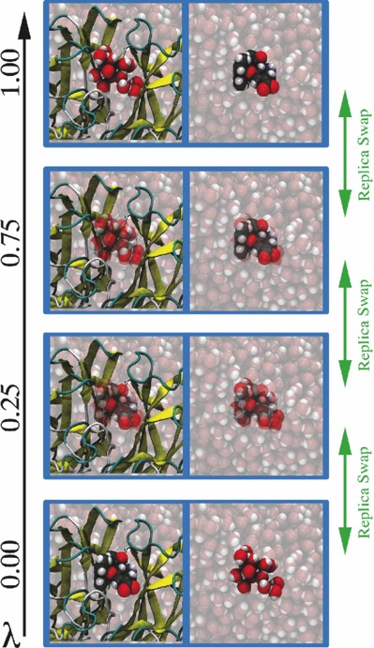

Case Study: Ligand Binding
Centre for Computational Chemistry, Bristol
  New methods for rapid MC sampling of biomolecular systems modelled using QM/MM
  Developed two codes ProtoMS (F77) + Sire (C++)
  Water-Swap Reaction Coordinate method to calculate absolute protein-ligand binding free energies
SSI’s work helped assess users + scale devs
  Ran user observations with 4 different users
  ASPIRE/ACQUIRE framework has multiple devs
    Split architecture between ASPIRE (adaptive multiresolution hybrid MD simulation) and ACQUIRE (WorkPacket scheduling system with optimisation for time to result vs “green-ness”
http://www.software.ac.uk/resources/case-studies/getting-grips-molecules
http://www.siremol.org/adaptive_dynamics

Slide 14
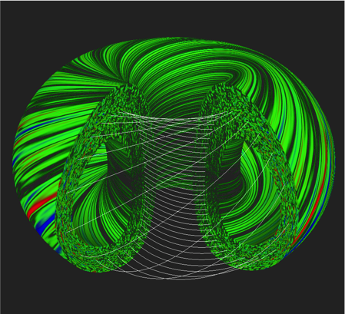

Case Study: Fusion Plasma
Culham Centre for Fusion Energy
  GS-2 used to study low-frequency turbulence in
  magnetized plasma
  No common visualisation across different groups
  Deliver mutually agreeable framework that can
  be extended easily and can be maintained by
  the small fusion community
SSI’s work means the software can be used
between groups
  Simplified & enhanced plasma visualisation tool
    Based on ParaView o/s tool
    For simulations using GS-2 o/s package
  Aim to allow CCFE to contribute back to GS-2 community
  “I am very confident the tool will be invaluable”
    Colin Roach, CCFE
http://www.software.ac.uk/who-do-we-work/culham-centre-fusion-energy
http://www.ccfe.ac.uk/

Slide 15
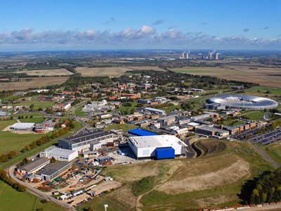

Case Study: ICAT
Science and Technology Facilities Council
  Metadata catalogue, used by RAL UK (ISIS,
  DIAMOND, CLF), SNS US, ELLETRA Italy
  ICAT operationally critical at sites
  Huge projects looking to use ICAT
  (PaNdataODI, EuDAT)
  Scalability issues and lack of proper processes
SSI’s work provided 33 recommendations
  15 interviews with different stakeholders
  92 observations set out in report
  “…we must focus on doing the right things, and
  this report will help us”
    Alistair Mills, STFC
  Governance and outreach changes to support additional users
http://www.software.ac.uk/preparing-icat-thousands-new-users
http://www.icatproject.org/

Slide 16
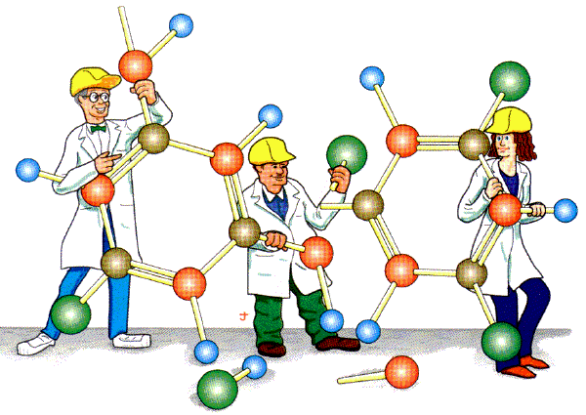
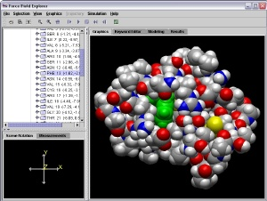
Case Study: Tinkering with APES
NSF/EPSRC Funded
  Polarisable empirical force fields (AMOEBA)
  AMBER, Tinker, DL_POLY, ONETEP,
  Q-Chem
SSI’s work is helping to coordinate development across many packages and many people
  Different languages, licenses,
  styles, teams
http://apes-soft.github.io/

Slide 17
Software
Training
Helping the community to develop software that meets the needs of reliable, reproducible, and reusable research
Delivering essential software skills to researchers via CDTs, institutions & doctoral schools
Outreach
Exploiting our platform to enable engagement, delivery & uptake
Collecting evidence
on the community’s software use & sharing with stakeholders
Bringing together
the right people to understand and address topical issues
Policy
Community

Slide 18
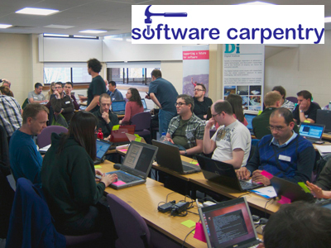

SSI Training
Software Carpentry
  http://software-carpentry.org
  International initiative to teach basics of software engineering to computational researchers
    The “why” more than the “how”
  Phenomenally successful – 2x oversubscription
  Cheap to run but budget for 3x the coffee!
  SSI are UK Coordinators for SWC
  We ran 13 workshops in 2013 to 600+ learners
Software Sustainability Surgeries
  “Bring your own code”
  “What makes Good Code good?”
  Run at existing conferences, and for software funding programmes
  Offering bespoke advice as well as training

Slide 19
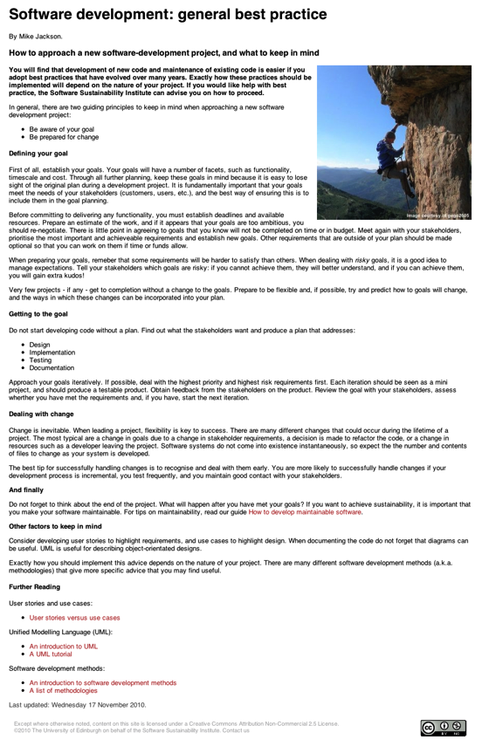
SSI Guides and Top Tips
Guides provide in depth information
  Licences
  Software development
  Project management
  Repositories and project infrastructure
  Open source
  Community building
  Publicising software
  Policy
Top Tips provide quick overviews
  Software development
  Repositories and project infrastructure
  Software carpentry
  Citing software
  Data handling
  Promoting and communicating your project
  Community building and project management
Notes:
42 Guides
33 Top Tips – many provided by community

Slide 20
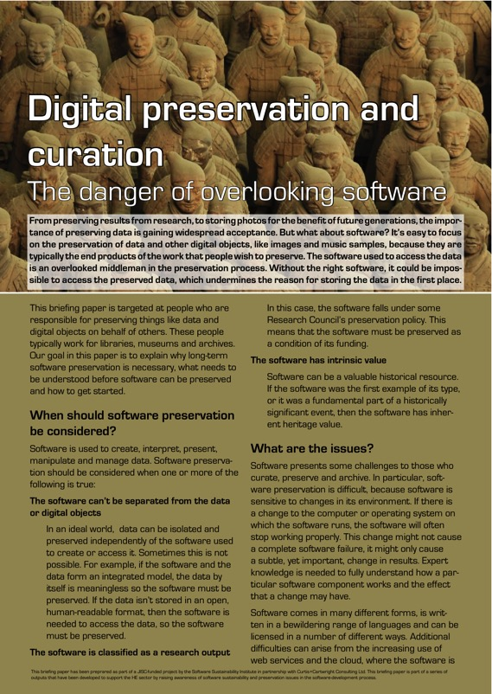
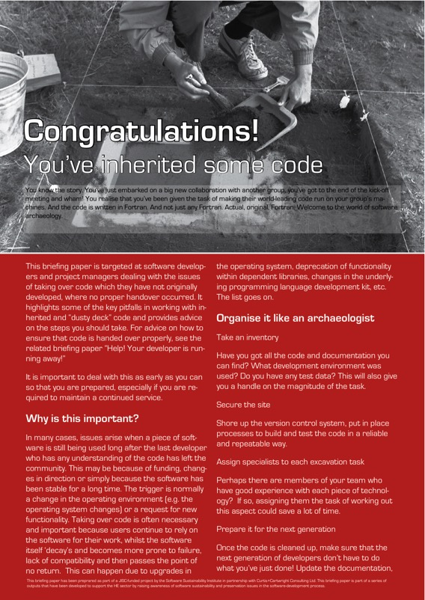

SSI Briefing Papers

Slide 21
Software
Training
Helping the community to develop software that meets the needs of reliable, reproducible, and reusable research
Delivering essential software skills to researchers via CDTs, institutions & doctoral schools
Outreach
Exploiting our platform to enable engagement, delivery & uptake
Collecting evidence
on the community’s software use & sharing with stakeholders
Bringing together
the right people to understand and address topical issues
Policy
Community

Slide 22
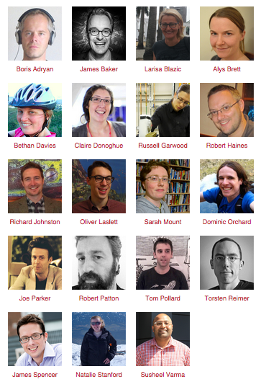
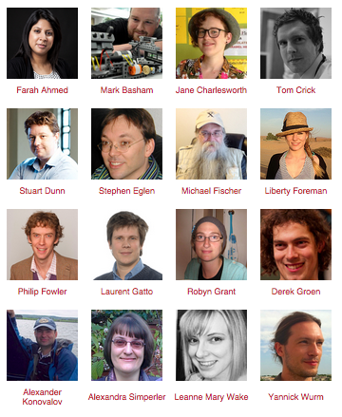
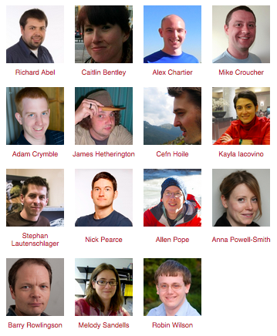
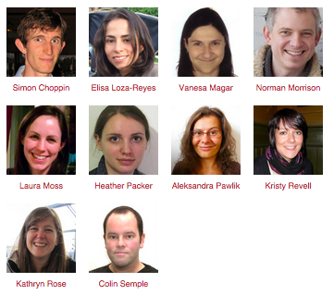
SSI Fellows
2015:
19 fellows
2014:
16 fellows
2013:
15 fellows
2012:
10 fellows
Range of subjects, career stages
software.ac.uk/fellows

Slide 23
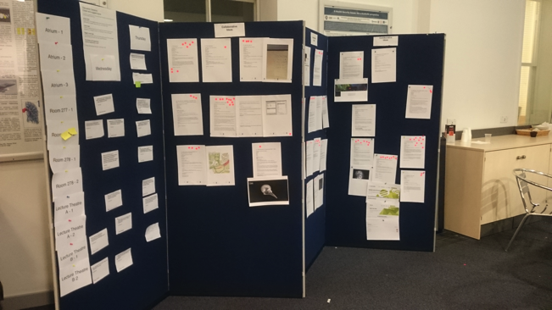
SSI Workshops
Flagship Collaborations Workshop
  Un-conference
  Lightning talks, discussions, hackathon
  From ideas to implementation
Topic specific workshops
  IP and Licensing
  Medical data
International WSSSPE series

Slide 24
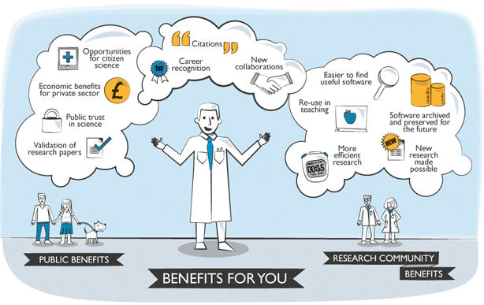
Journal of Open
Research Software
http://openresearchsoftware.metajnl.com
Notes:
A metajournal which encourages the publication of information that encourages the reuse of software.
A way of using the current tools and practices to make software better recognised.

Slide 25
Software
Training
Helping the community to develop software that meets the needs of reliable, reproducible, and reusable research
Delivering essential software skills to researchers via CDTs, institutions & doctoral schools
Outreach
Exploiting our platform to enable engagement, delivery & uptake
Collecting evidence
on the community’s software use & sharing with stakeholders
Bringing together
the right people to understand and address topical issues
Policy
Community

Slide 26
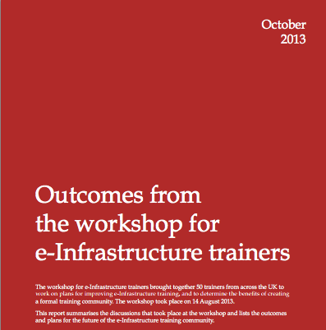
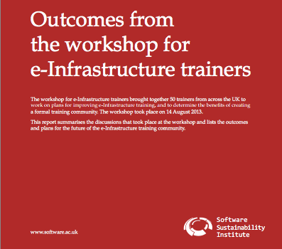
Creating a training community
Bringing together 39+ organisations with interest in e-Infrastructure training
Raising issues and enablers with RCUK, BIS
software.ac.uk/policy

Slide 27
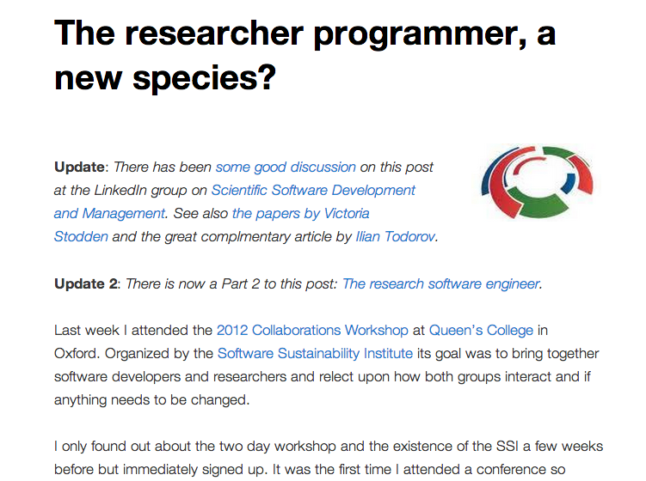
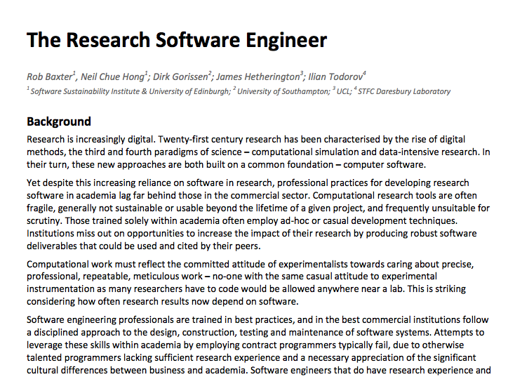
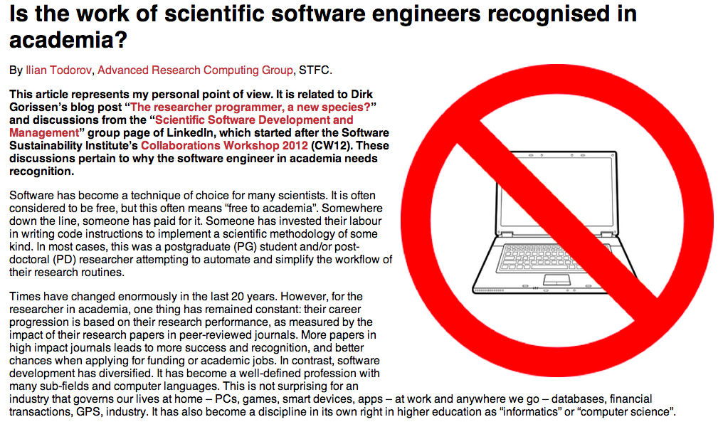
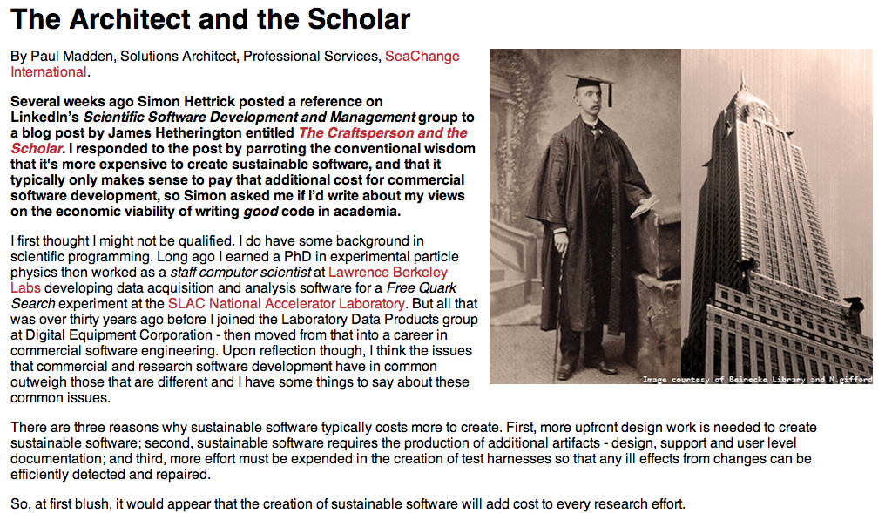
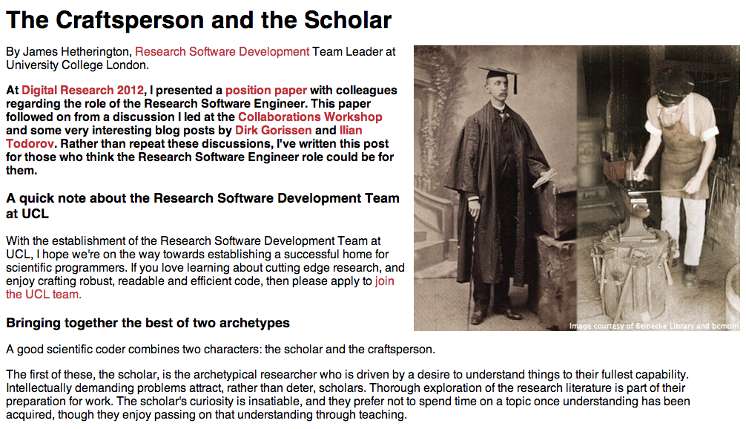
Campaigning for careers
software.ac.uk/policy

Slide 28
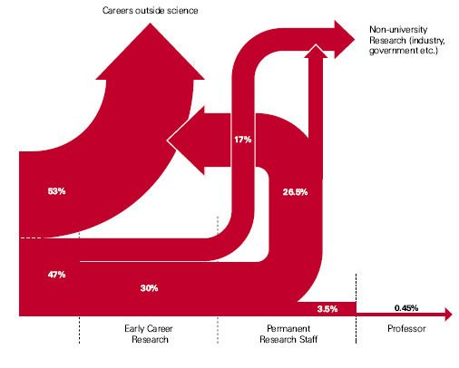
Career Paths in UK
Careers outside academic sector
Non-university
Research (industry,
government etc.)
UK STEM graduate career paths
PhD students
Early Career
Research
Permanent
Research Staff
Professor
Source: The Scientific Century, Royal Society, 2010 (revised to reflect first stage clarification from “What Do PhD’s Do?” study)

Slide 29

Research Software Engineer
Join the RSE community at http://www.rse.ac.uk/

Slide 30
Software
Training
Helping the community to develop software that meets the needs of reliable, reproducible, and reusable research
Delivering essential software skills to researchers via CDTs, institutions & doctoral schools
Outreach
Exploiting our platform to enable engagement, delivery & uptake
Collecting evidence
on the community’s software use & sharing with stakeholders
Bringing together
the right people to understand and address topical issues
Policy
Community

Slide 31


SSI Website
Disseminating best practice, gathering information
20,000+ unique visits/month

Slide 32


SSI Blog
Articles on research software and related issues
  Ask the Institute
  A Day in the Software Life
  Heroes of Software Engineering
  Top Tips
  Women in Software
150+ posts written by external contributors
  10,000+ unique pageviews/month
  Twitter, Reddit

Slide 33
Support for research means support for software.
Support for software means supporting the people using and developing it.

Slide 34




Find out more about the SSI
Community Engagement (Lead: Shoaib Sufi)
  Fellowship Programme
  Events and Workshops
Consultancy (Lead: Steve Crouch)
  Open Call for Projects / Collaborations
  Software Evaluation
Policy and Publicity (Lead: Simon Hettrick)
  Case Studies / Policy Campaigns
  Software and Research Blog
Training (Lead: Aleksandra Pawlik)
  Software Carpentry (300+ students/year)
  Guides and Top Tips
Journal of Open Research Software (Editor: Neil Chue Hong)
Collaboration between universities of Edinburgh, Manchester, Oxford and Southampton

