Slide 1

A Paradigm Shifts in Supercomputing
Past, Present, and Future
NSC 2019 – Keynote Address
Thomas Sterling
Professor of Intelligent Systems Engineering
Director, Continuum Computer Architecture Laboratory
School of Informatics, Computing, & Engineering
Indiana University
January 31, 2019

Slide 2
Summit – at the peak of TOP-500
US DOE
CORAL-1 Machine
Oak Ridge National Lab
IBM with NVIDIA
Peak Performance: 200 Pflops
R_{max} 122.3 Pflops
9216 Power9 CPU
27,648 Tesla V100
8,000+ square feet
15 Mega-Watts

Slide 3
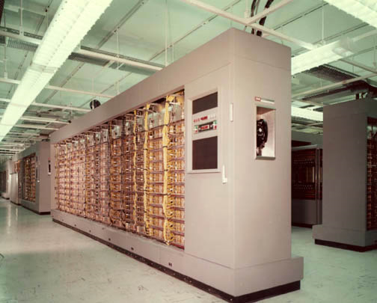
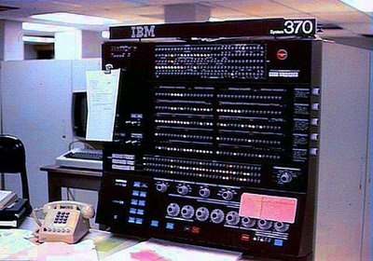
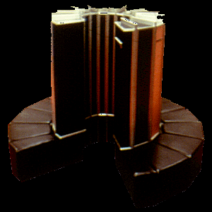
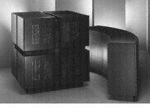
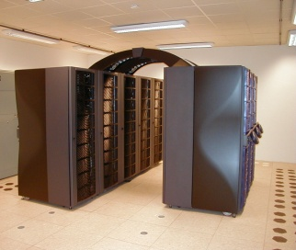
Discovering the Future of Computing
Product of punctuated equilibrium era
  Genesis – ENIAC, von Neumann Architecture, EDSAC, UNIVAC 1, AIS, Whirlwind, IBM 704, ERA 1103
  Transistor – IBM 7090, DEC PDP-1, CDC 1604
  Integrated Circuits SSI – IBM 360, DEC PDP-8, CDC 6600
  MSI – CRAY-1 vector computing
  LSI – TMC CM-2, MASPAR-1, SIMD
  VLSI – MPP, Beowulf, Intel Touchstone Delta, TMC-5, Cray T3E, Red Storm
  Multi-core – IBM Roadrunner, Sunway TaihuaLight
  GPU – heterogeneous, Cray ORNL Titan
Product of incremental extensions era
  Gap filling/flat-lining – decided what final solution is; keep the power down; bigger machine
  Curiosity-driven-research an anathema; abrogated by labs and vendors, academia need not apply (except for apps)
  MPI + OpenMP + … +

Slide 4
Projected Performance Development
10 Eflop/s
1 Eflop/s
100 Pflop/s
10 Pflop/s
SUM
1 Pflop/s
100 Tflop/s
N=1
10 Tflop/s
1 Tflop/s
N=500
100 Gflop/s
10 Gflop/s
1 Gflop/s
100 Mflop/s
Courtesy of Erich Strohmaier
Notes:
No500 is lagging 10x by end of decade if this continues
EXP(0.325x) top500 last old
Exp(0.2124 x ) top500 last new
Exp(0.1843 x) scalar
Exp(0.219 x) accelerator
Exp(0.3061 x) top500 average prior 2013
Exp(0.1379 x) top500 average post 2013 => *2.28 in 6 lists since 2008

Slide 6
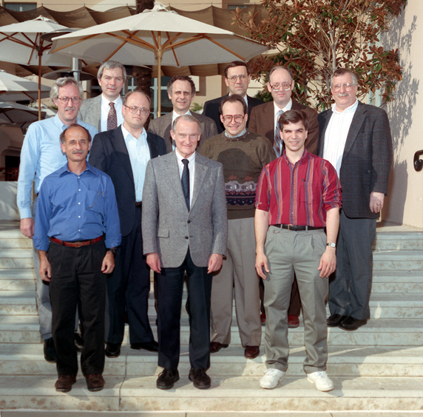

Slide 7
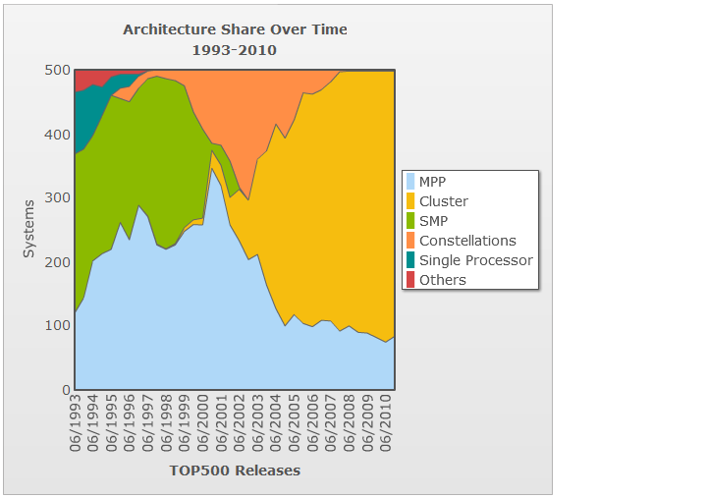
Top 500 System Architectures – But there’s more!

Slide 8
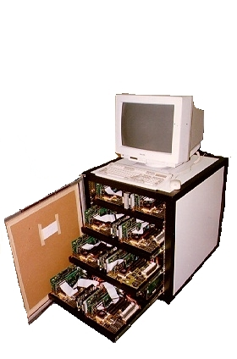
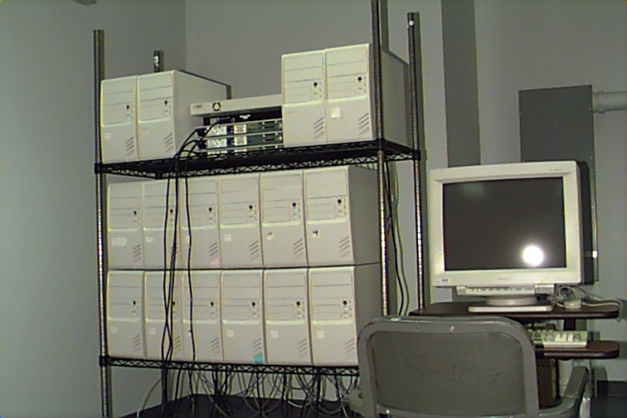
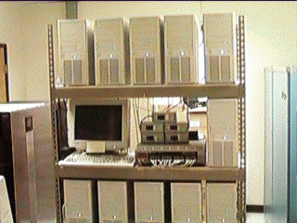
NASA Beowulf Project
Wiglaf - 1994
16 Intel 80486 100 MHz
VESA Local bus
256 Mbytes memory
6.4 Gbytes of disk
Dual 10 base-T Ethernet
72 Mflops sustained
$40K
Hrothgar - 1995
16 Intel Pentium100 MHz
PCI
1 Gbyte memory
6.4 Gbytes of disk
100 base-T Fast Ethernet (hub)
240 Mflops sustained
$46K
Hyglac-1996 (Caltech)
16 Pentium Pro 200 MHz
PCI
2 Gbytes memory
49.6 Gbytes of disk
100 base-T Fast Ethernet (switch)
1.25 Gflops sustained
$50K

Slide 9
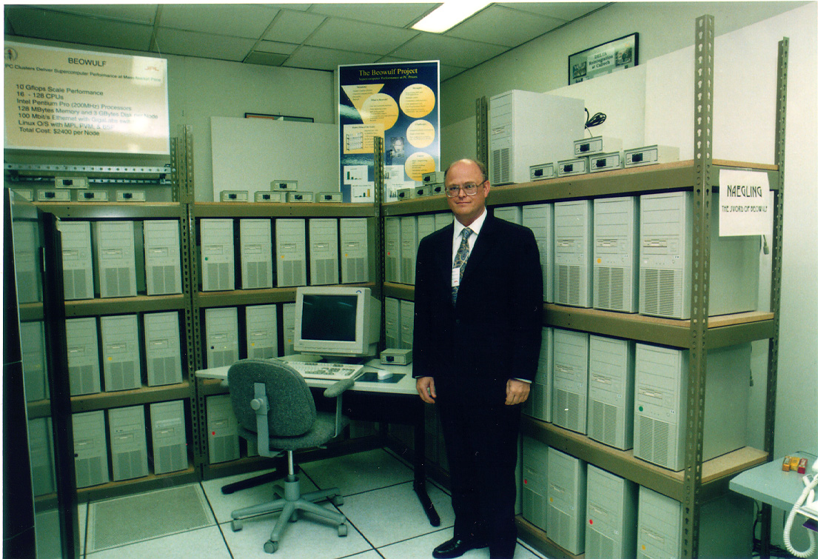

Slide 10
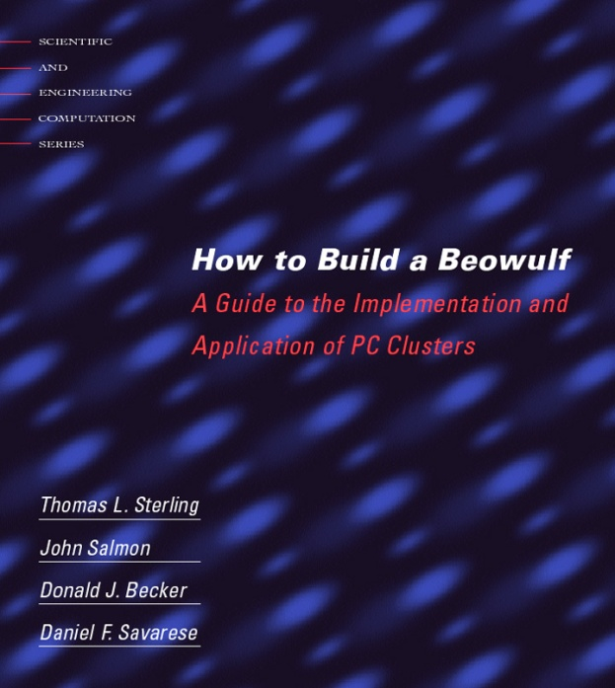
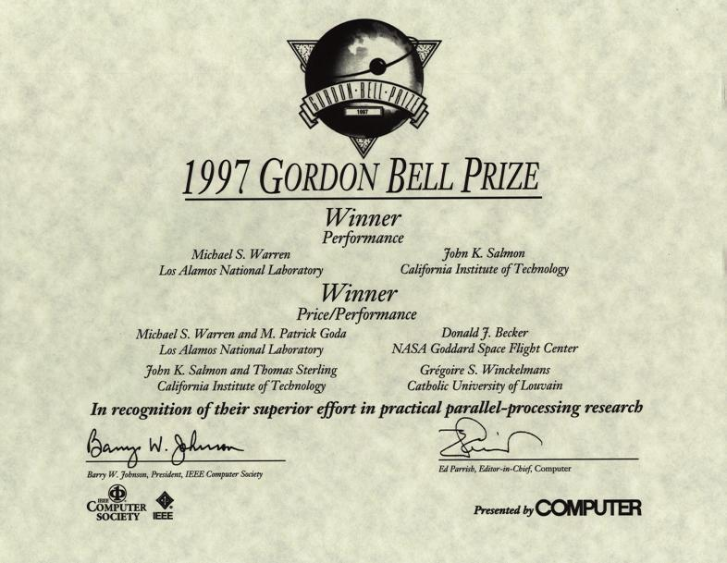
Beowulf Accomplishments
An experiment in parallel computing systems
Established vision of low-cost HPC
Demonstrated effectiveness of PC clusters for some classes of applications
Provided networking software in Linux
Mass Storage with PVFS
Provided cluster management tools
Achieved >10 Gflops performance
Gordon Bell Prize for Price-Performance
Conveyed findings to broad community
Tutorials and the book
Provided design standard to rally community
Spin-off of Scyld Computing Corp.
Hive at GSFC

Slide 11
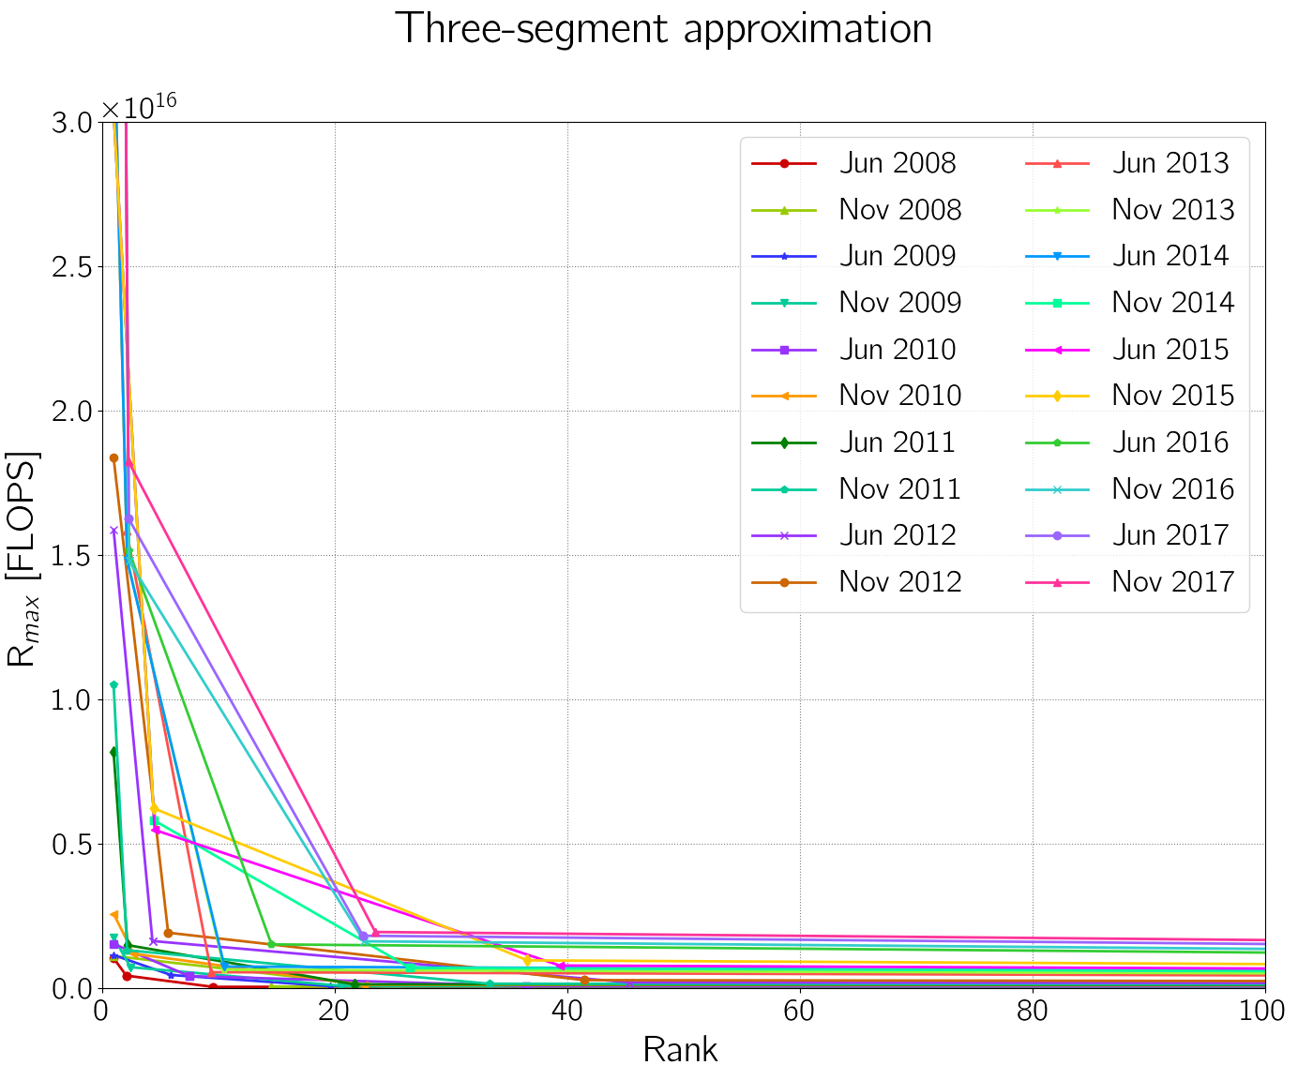
Three Worlds of Supercomputing

Slide 12
Sources of Asynchrony for Exascale
Scale
Increase range of network latencies and opportunities for packet collisions and routing variations
Deeper memory hierarchy
Scheduling conflicts for threads to cores
Active response to errors
Variable instruction rate from clock and voltage change
Finer grain threads as normalization factor of time delays

Slide 13
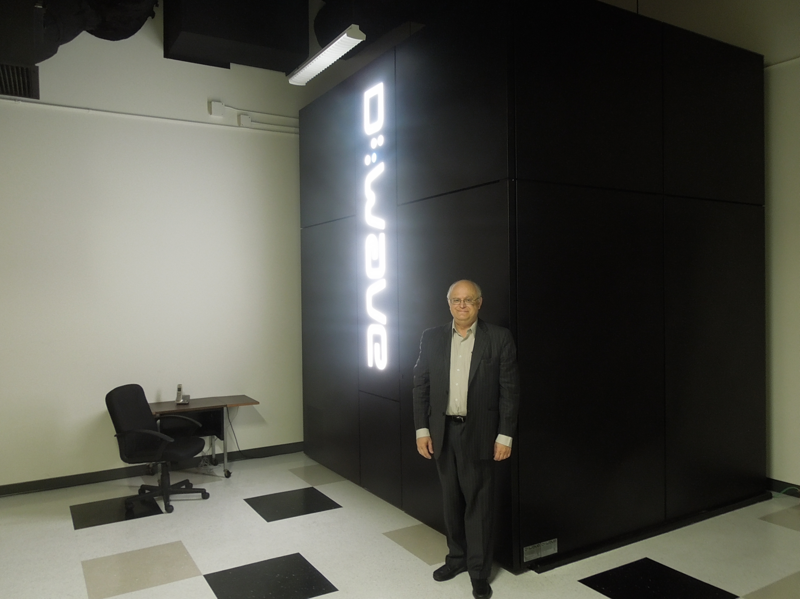

Beyond Exascale
Quantum Computing
  Exploits quantum mechanics
  Uses superposition, tunneling, entanglement
  Might solve problems otherwise impossible
  Still in research, but promising
Neuromorphic Computing
  Brain inspired
  Neural networks early example
  Uses training sets in many cases
Superconducting Supercomputing
  Josephson junctions for quantum flux gates
  Potentially 100’s of GigaHertz clock rate
Processor in Memory (PIM)
  Merges logic at sense amps of memory
  Reduces latency, increases bandwidths

Slide 14
Beyond Moore’s Law – Neo Digital Age
Computing systems are largely von Neumann derivatives
  MPPs
  SIMD
  Vector
  ILP
  Multiple threads
Imposed constraints from von Neumann model
  Sequential instruction issue
  Optimize ALU/FPU utilization
  Separation of processor and memory
New strategy: Reverse legacy of driver biases
  FPU availability and lowest latency to data
  Hardware support of overhead mechanisms for parallelism control
  Merge of memory, logic, and communication for low latency and energy of data movement

Slide 15
Performance Factors - SLOWER
Starvation
  Insufficiency of concurrency of work
  Impacts scalability and latency hiding
  Effects programmability
Latency
  Time measured distance for remote access and services
  Impacts efficiency
Overhead
  Critical time additional work to manage tasks & resources
  Impacts efficiency and granularity for scalability
Waiting for contention resolution
  Delays due to simultaneous access requests to shared physical or logical resources
P = e(L,O,W) * S(s) * a(r) * U(E)
P – performance (ops)
e – efficiency (0 < e < 1)
s – application’s average parallelism,
a – availability (0 < a < 1)
U – normalization factor/compute unit
E – watts per average compute unit
r – reliability (0 < r < 1)

Slide 16
Challenges to HPC – beyond Moore’s Law
End of exponential growth of feature size density
Bounded power consumption of semiconductor die
Flat-lining of clock rates
Increase degrading impact from von Neumann bottleneck
Overhead versus granularity roofline for strong scaling
Lack of parallel flow control semantics and mechanisms
Increase latency of data and resource access
Worsening uncertainty of asynchrony
Parallel flow control operation essential
Single point failure modes

Slide 17
Strategic Pivot Point – A Neo Digital Age
Technology trends suggest end of exponential growth from Moore’s Law
Innovations in computer architecture may provide future performance gains in the nano-scale semiconductor era
  Extreme heterogeneity; e.g., GPU
  Paradigm shift; e.g., quantum computing, neuromorphic
Address SLOWER performance factors
Computing systems are largely von Neumann derivatives
Caltech/CACR CCA-project sponsored by DARPA
  Ultra-fine-grained architecture
  Smart memory
ParalleX provides governing principles for global emergent behavior

Slide 18
Goals of a New Execution Model for Exascale
Serve as a discipline to govern future scalable system architectures, programming methods, and runtime
Latency hiding at all system distances
  Latency mitigating architectures
Exploit parallelism in diversity of forms and granularity
Provide a framework for efficient fine-grain synchronization and scheduling (dispatch)
Enable optimized runtime adaptive resource management and task scheduling for dynamic load balancing
Support full virtualization for fault tolerance and power management, and continuous optimization
Self-aware infrastructure for power management
Semantics of failure response for graceful degradation
Complexity of operation as an emergent behavior from simplicity of design, high replication, and local adaptation for global optima in time and space
Notes:
The strategy of employing a new model of parallel computation as a conceptual framework for co-design of advanced systems to catapult HPC through this phase change is viable only if it serves as an enabler and tool to this end. It is not intended nor should be employed as an imposition to restrict creativity or alternatives. Rather it should accelerate progress towards an effective solution. It is an open question whether this process will culminate in a single unified model for all things or a small collective of disparate but complementing models that enable alternative operating points, each of its own value to some subset of the user community.
The principal goal of a new model of parallel computation is to serve as a conceptual framework to govern the co-design and interoperability of all the layers in the system stack from programming models down to core architectures and all of the hardware and software levels in between. It is a discipline to specify a (not “the”) system hierarchy, the functionality and characteristics of each level, and the protocols employed to support their interaction and mutual support. Such a model will enable and support many distinct design points consistent within the discipline. Furthermore, the possibility of multiple models of computation add an additional dimension to the richness of opportunity.
A major goal for the new model is the dramatic increase in useful program and execution parallelism. The new model of computation has to expose, exploit, execute approximately billion-way parallelism to reduce execution time to solution, increase performance to Exascale capability, to hide latencies and dynamically employ available resources for high efficiency, and exploit the hundreds of millions of cores and two orders of magnitude or more threads and ILP. Without a model that greatly expands by many orders of magnitude the amount of parallelism that may be applied, Exascale computing will not be impossible.
A second major goal is to enable the mitigation of local and global latency which can impose delays of from hundreds to tens of thousands of cycles within the system and orders of magnitude before if secondary storage is included. Conventional practices exploit avoidance, caching in the presence of temporal and spatial locality to memory, and prefetching. While these methods have some practical value, even in the future, they are restrictive and demand advanced structures and methods that overcome latency.
Overhead of task management including synchronization (ordering invariants), allocation (space), and scheduling (time) determines the granularity of parallelism that can be exploited as well as is a measure of waste in time, power, and resources. Overhead fixes the minimum fine grained parallelism that will contribute to scalability. Generally, (but not always) the smaller the task size that can be used, the more parallelism that will be available from a given application. For a fixed size problem overhead establishes a fundamental upper bound on scalability. A new model of computation must contribute to the opportunity to significantly reduce the effects of overhead while providing more flexible mechanisms to remove the over-constraining aspects of synchronization such as global barriers or only heavy weight communications.
Optimal use of systems by applications in many cases cannot be fully realized by compile time analysis only. This is because runtime information is necessary to make real time changes to best use resources to provide load balancing, contention avoidance for memory banks and network channels, and support optimal flow control. Dynamic adaptive resource management must be enabled by a new model of computation to get best use of systems and power.
In support of dynamic control for performance optimization, power management, and fault tolerance a shift from static mapping of processes to processors needs to be made to support dynamic mapping of tasks to resources. System reconfiguration or availability needs allocation decisions to be made on the fly. It is necessary that the hardware no longer permit an explicit direct mapped relationship to the software. Rather the executing actions need to be decoupled from the physical system such that it can be easily assigned to any hardware or a large subset thereof. This will permit the machine available to an application to be permitted to change in real time and the computation to be adjusted and continued in response. This is a virtualization that will enable fault tolerance, power management, and performance optimization.
The model of computation needs to support semantics that model, respond to, and manipulate system resources in the presence of failures for fault tolerance. Single point failure modes will exhibit MTBFs of minutes to seconds at Exascale configurations and check point restart will not work using conventional methods because the time to dump full memory will be greater than the MTBF. A future model has to embrace failure and provide semantics models that permit all the system layers to be designed to support fault tolerance.
Similarly, semantics of power monitoring and management will be required. A self-aware runtime component supported at all levels will be required to optimize energy usage. This self-aware agent can also be used for performance optimization and contribute to fault tolerance methods. Control of system Vdd, clock rate, and powered-up status can all contribute to reduction of energy per program.
Locality management both at compile time and runtime is important for reducing latency, reducing overheads, and reducing power consumption. Yet locality is the opposite from distribution and there is a healthy tension between the two as well as demanding support at many if not all levels of the system stack. The model of computation must support the means of achieving locality while providing for dynamically achieving the balance point between the two.
A major impedance to progress is the reliance on design complexity to realize operational complexity which will only increase with system scale and application complexity. A new model of computation has to support an alternative strategy for achieving complexity of operation which is to achieve it through simplicity of design of components combined with high replication and synergistic cooperation. The result will be complexity of operation as an emergent property through symbiosis.

Slide 19
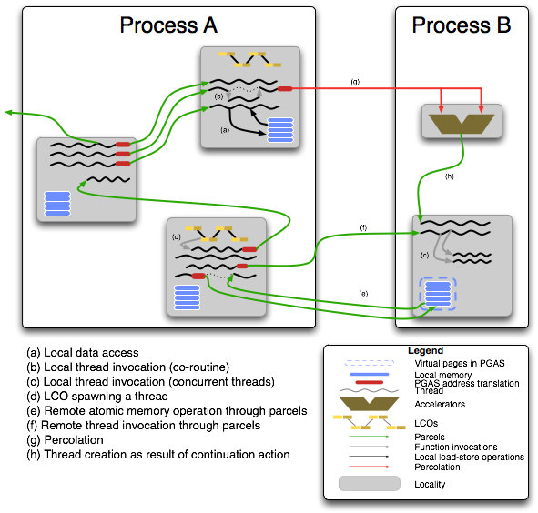
ParalleX Execution Model
Lightweight multi-threading
  Divides work into smaller tasks
  Increases concurrency
Message-driven computation
  Move work to data
  Keeps work local, stops blocking
Constraint-based synchronization
  Declarative criteria for work
  Event driven
  Eliminates global barriers
Data-directed execution
  Merger of flow control and data structure
Shared name space
  Global address space
  Simplifies random gathers
Notes:
This diagram illustrates many of the key semantic constructs and mechanisms of the ParalleX (PX) model of computation. The shaded squares represent physical localities. All operations within a locality are synchronous. All operations between localities are asynchronous. A process is a context that defines data and tasks to be performed on the localities to which it is assigned. A process may be allocated multiple localities; these not be in any way mutually local to each other. More than one process can share a locality (not shown). Process A is allocated three localities while Process B is on one locality but also uses a separate physical execution unit. Processes can incorporate child processes (not shown). Processes are illustrated by large rectangular transparent boxes.
Basic tasks in the ParalleX model are conducted by “threads” which are partially ordered instructions working on a potentially infinite set of registers. This convenient abstraction minimizes the number of anti-dependencies to permit easy back end compilation to diverse ISA and data paths for different cores. In the diagram, the threads are represented by black worm-like “squiggly” lines. While a process may span multiple localities, a thread by definition resides on only one locality at a time and usually (but not necessarily) on a single locality throughout its lifetime. Threads are ephemeral: each is created at some point in time, performs its work, and terminates. A thread may be suspended but the ideal thread is relatively lightweight, works only on local data and terminates quickly. The effect of a thread may be manifest in several ways: 1) it changes local mutable state, 2) it creates sibling threads (or processes) that outlive it, or 3) it creates parcels that invoke remote threads (or processes) or change remote mutable state. Threads are first-class objects with names in the same name space as variables and objects. They can be manipulated by other threads potentially of other processes. Threads can be suspended to form objects called “depleted threads”. A depleted thread contains all the private state of an active thread but takes up no physical execution resources other than a little main memory space. A depleted thread is a first class object and has the same virtual address of the original thread from which it is derived. Therefore, it can be accessed; its state modified; and, it can cause a new thread with the original name to be created (equivalent to reactivating the old thread). Threads perform almost all the work of the program. The exception is the parcel that directly effects remote state without invoking a thread.
Parcels are a class of active messages. They are illustrated by the green lines that connect between localities. Parcels support semantics at remote localities that threads can perform directly within their resident locality. These are creating remote threads or processes, changing remote state through compound atomic operations, or manipulating threads or processes directly. A parcel carries four types of information: a) the name (virtual address) of the object upon which it is to operate, b) the action to be performed, c) a set of operand values, and d) a continuation specifying what is to happen upon completion of the specified action. The actions can be thread invocations, process instantiations, or primitive compound atomic operations on virtual data or physical devices with physical addresses. Parcels support asynchronous operation of the ParalleX environment. Parcels can arrive at any time and order of arrival is not guaranteed. They can be relatively short with little or no operand values, or be very long when used to move blocks of data. Parcels are not first class objects and do not have virtual names. Locally at the source and destination localities parcels do display handles for local manipulation. Parcels belong to a global object called the “parcel set”.
A special form of the parcel is used for a methodology called percolation. Percolation moves the entire work foot print of a thread to a remote physical execution site. It is illustrated by the red lines between thread and functional unit. By foot print it is meant to include the instructions of the thread, the stack frame of the thread, the input arguments used for the thread, and any other information required to fully instantiate the thread on the remote execution site. Percolation is used to make efficient use of relatively precious resources like accelerators, GPUs, FPGAs, or expensive streaming processors. It does so by assuming the overhead and hiding the latencies that such a unit would otherwise have to incur. Thus percolation supports prestaging of execution information. Percolation is also used to dynamically allocate new resources within a system to an application program.
A critical element to the management and coordination of global parallel flow control is the Local Control Object of “LCO” shown as small yellow/brown-green splotches. An LCO is a synchronization object in the object-oriented sense. It has associated with it both state and methods that operate upon the state. LCOs are first-class objects in that they have names that are virtual addresses like other variables. The purpose of the LCO is to coordinate global flow control by means of a number of different types of synchronization mechanisms from simple mutex elements to sophisticated dataflow templates and futures constructs. An LCO is accessed like any other object locally by a thread or remotely by a parcel possibly changing its state. An LCO includes one or more criteria which if satisfied will result in the instantiation of a thread. LCOs can also buffer incoming requests until such a condition can be satisfied. This may include the availability of physical resources. The LCO is the embodiment of a continuation. The continuation field of a parcel with some exceptions is a reference to one or more LCOs.

Slide 20
Hierarchical Structure – ParalleX Components
High Level Paradigm
  Formal specification, operational semantics
ParalleX Process*
  Active Global Address Space
  Spans multiple localities (nodes)
  Ephemeral
  Virtual address based on tree hierarchy
  Methods access for off parent-child span
Computing Complex*
  Locally instantiated; all ops and private data in same locality
  Resides in a single process
  Partially ordered dataflow structured operations
  Ephemeral
  Instantiation: eager/lazy, strict/relaxed
Local Control Objects*
  Powerful synchronization
  Dataflow
  Futures
  custom
Parcels
  NOT 1st class
  Instantiates local or global tasks
    Causes messages if remote
    Direction complex if local
  Packages task required information
    Action to be performed
    Destination object virtual address
  Operand values
    By value, reference, LCO
  Continuation
    What happens after
    Error response
* Indicates first-class entities within ParalleX

Slide 21
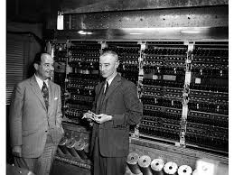
Reversing Von Neumann Architecture Heritage
Optimization of ALU/FPU utilization
  Presumes that FPU is most valuable resource
Separation of compute logic and memory
  Referred to as “von Neumann bottleneck”
  Consequence of early disparate enabling technologies
  Demands complicated cache hierarchy
Sequential instruction issue
  Constrains natural parallelism
Sequential consistency memory model
  Narrows ordering of global mutable side-effects
  Imposes cache coherence mechanisms
Registers of isolated local name space
  Load/store operations
  Logically insular
  Causes register overflows
  Fixed length

Slide 22
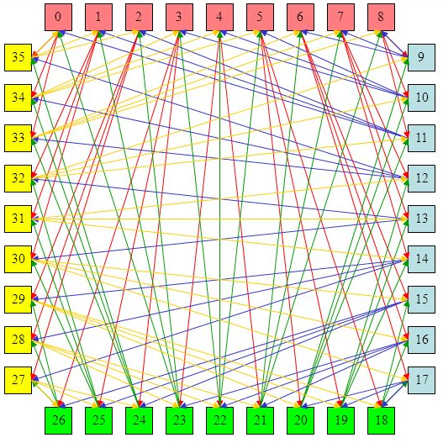
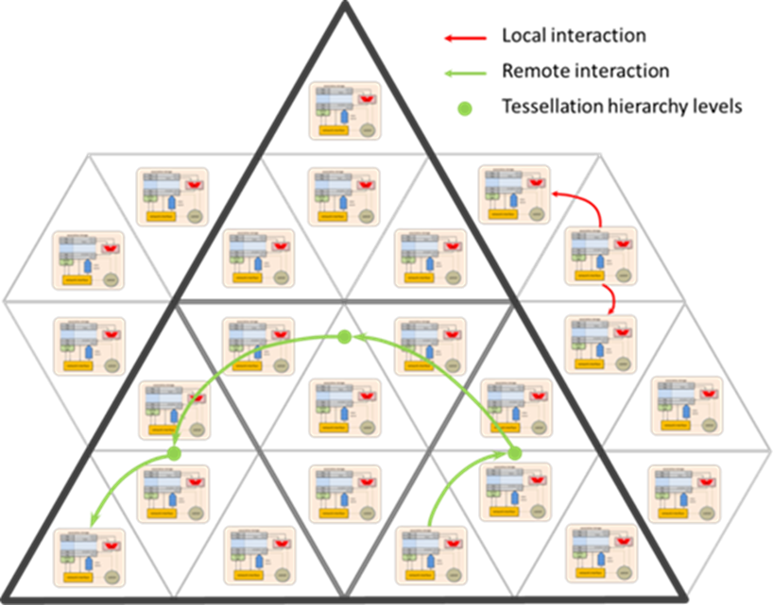
Fundamental System Components
Shared ALU
Ports
Tag
Memory Block
Tag
Memory Block
Compute-cell
  Storage
  Logic
  Neighbor interface
On-chip low-latency network
  Hierarchical
Socket
  Stacked and unstacked versions
  Fonton chip(s)
  Stack includes DRAM and network driver chips
Module
  1U enclosure
  Four boards
Global interconnect
  On-board and inter-board
  Electrical medium for short distance
  High radix and fiber optics for machine scale
Tag
Memory Block
Tag
Memory Block
Decode & Execute
Neighbor Interface

Slide 23
Computing Cell Transistor Budget
Function unit | Transistor count | Unit count | Total transistor count
32-bit multiplier | 21000 | 1 | 21000
16-bit multiplier | 9000 | 3 | 27000
8-bit multiplier | 3000 | 4 | 12000
64-bit adder/subtractor | 3072 | 1 | 3072
64-bit adder | 896 | 2 | 1792
64-bit NOT | 128 | 3 | 384
64-bit AND | 384 | 3 | 1152
64-bit OR | 384 | 3 | 1152
64-bit XOR | 384 | 3 | 1152
64-bit barrel shifter | 2304 | 2 | 4608
Processing logic: 108K
  Wide ALU: 73K
  Instruction decode: 6K
  Address match unit: 19K
  Data path: 8K
  Packet routing: 2K
Storage: 101K
  Shown in the table
Total: 209K
  Roughly 50/50 split logic/memory
  ALU is multiplier heavy
  64-bit multiplier too expensive at ~100K transistors
  Further savings possible by resource sharing across several fontons
Storage type | T per bit | Bits | Total
Active memory | 10 | 8192 | 81920
Synchronization | 8 | 128 | 1024
Type info | 6 | 768 | 4608
Address tags | 6 | 928 | 5568
Packet buffer | 8 | 1024 | 8192

Slide 24
System Capacities and Capabilities
Level | C-Cells | Chips | Sockets | Boards | Modules
Chip | 11K | 1 | - | - | -
Socket | 43.8K | 4 | 1 | - | -
Board | 16.3M | 1,488 | 372 | 1 | -
Module | 65.2M | 5,952 | 1,488 | 4 | 1
Rack | 2.74G | 250K | 62.5K | 168 | 42
System | 65.7G | 6M | 1.5M | 4,032 | 1,008
Level | Peak OPS | Peak Flops | Active memory [bytes] | DRAM [bytes] | Peak memory bandwidth [bytes/s] | Peak NN Bandwidth [bytes/s]
C-Cell | 128M | 16M | 1K | - | 3.07G | 4.1G
Chip | 1.4T | 175G | 11.2M | - | 33.6T | 44.9T
Socket | 5.61T | 701G | 44.9M | 1.07G | 135T | 179T
Board | 2.09P | 261T | 16.7G | 399G | 50.1P | 66.8P
Module | 8.35P | 1.04P | 66.8G | 1.6T | 200P | 267P
Rack | 351P | 43.8P | 2.8T | 67.1T | 8.41E | 11.2E
System | 8.41E | 1.05E | 67.3T | 1.61P | 202E | 269E

Slide 25
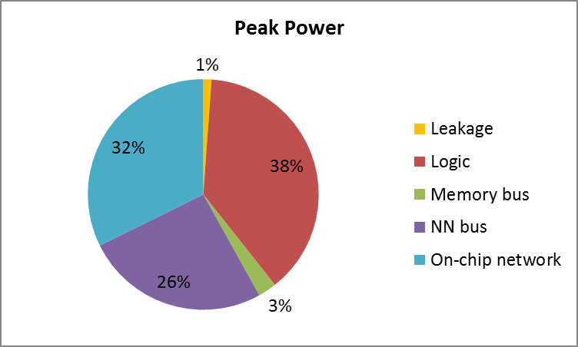
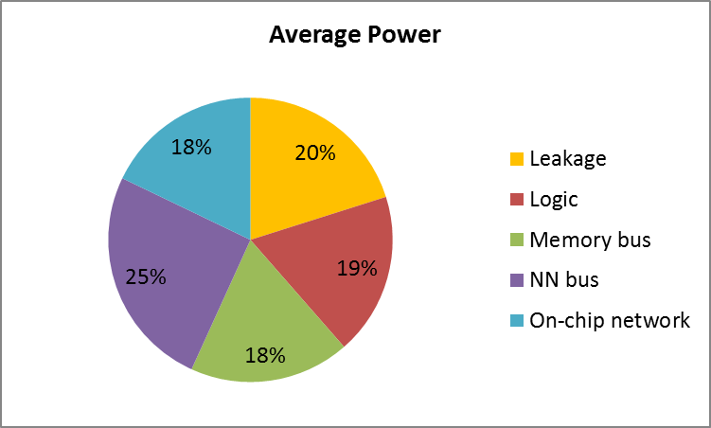
Power Requirements: Chip
Component | Peak power [W] | Average power [W]
Logic | 7.7 | 0.21
Memory bus | 0.52 | 0.21
NN interface | 5.2 | 0.29
On-chip network | 6.5 | 0.2
Leakage | 0.23
Total | 20 | 1.14

Slide 26
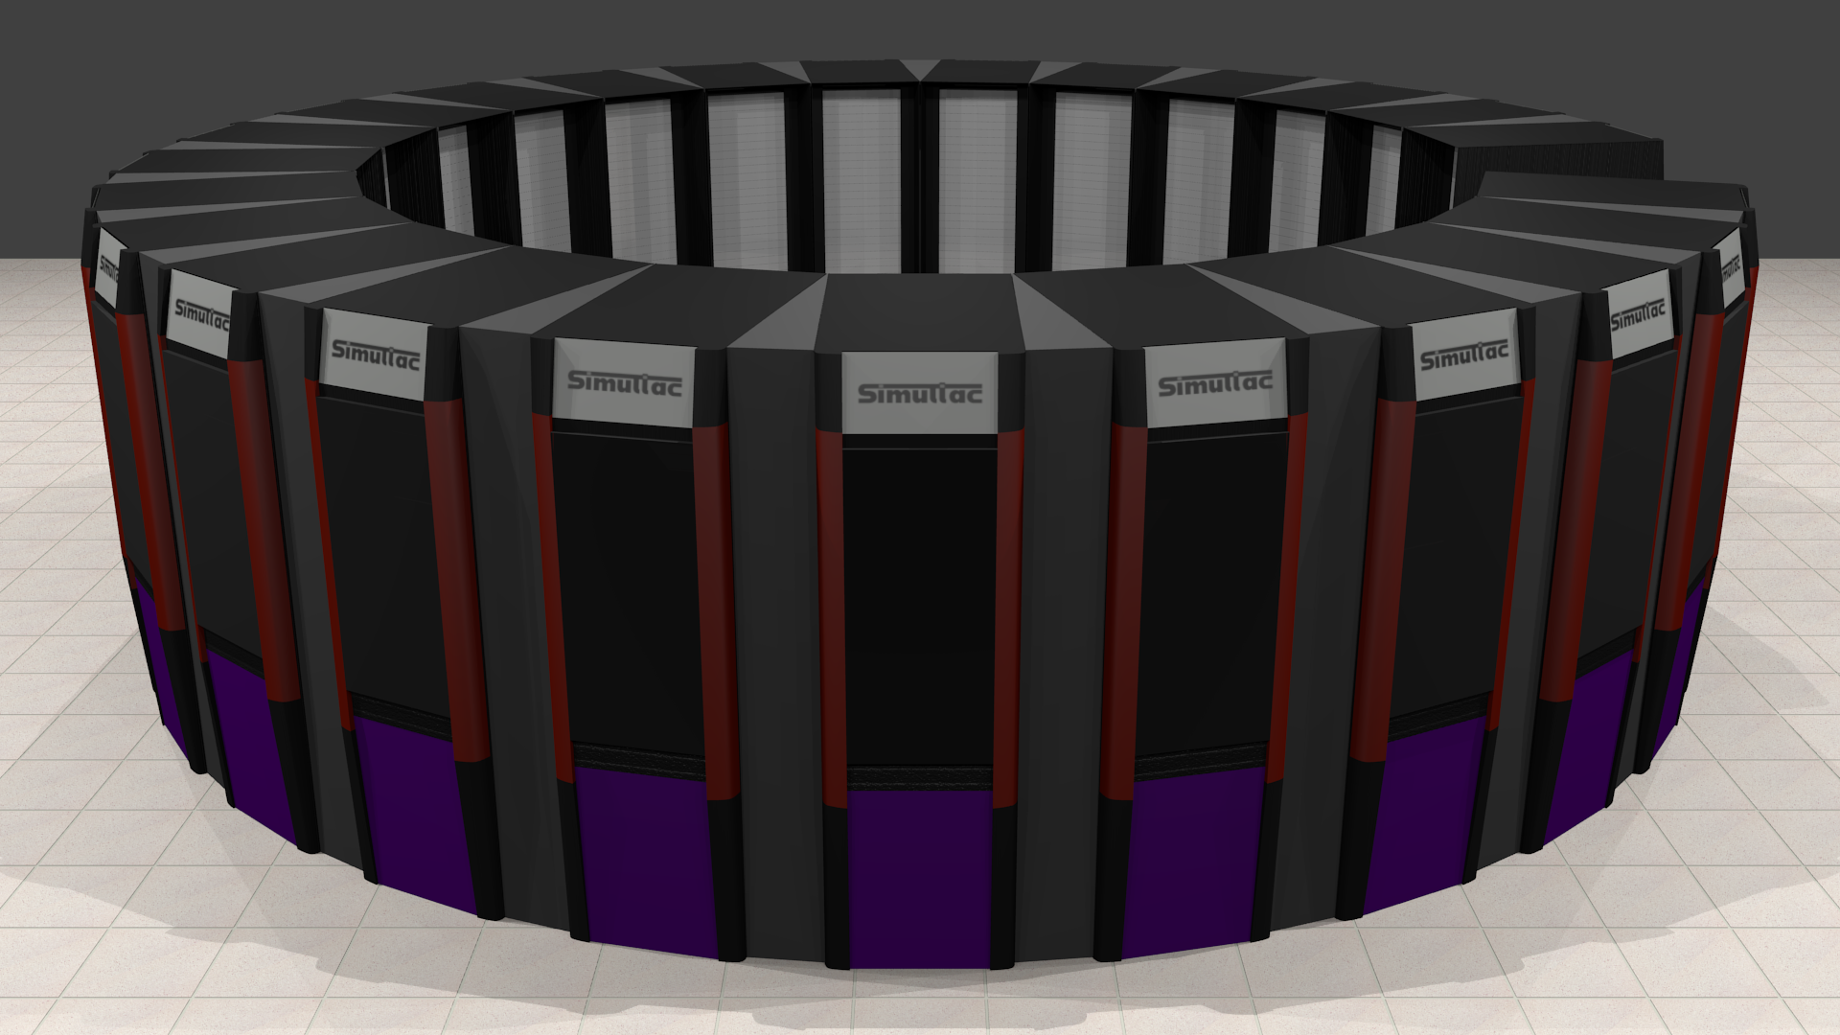
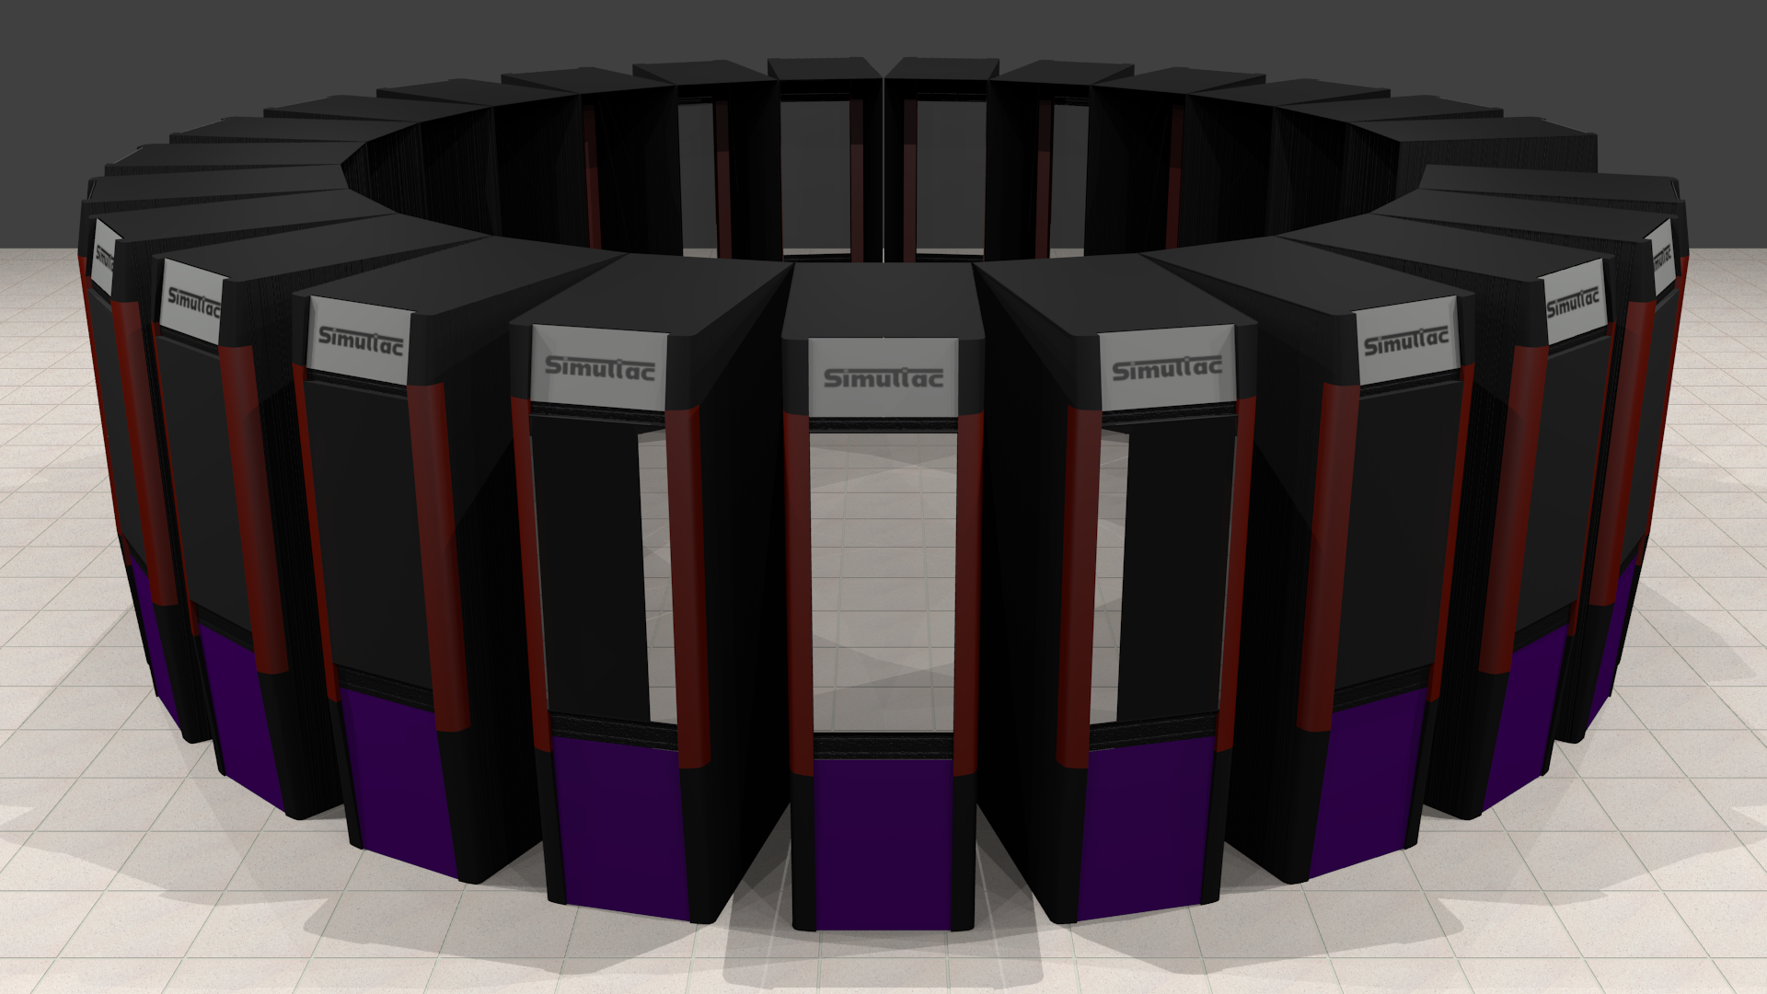
Exaflops CCA System
Footprint: 36.9 m² (396 ft²), Weight: 30,120 Kg

Slide 27
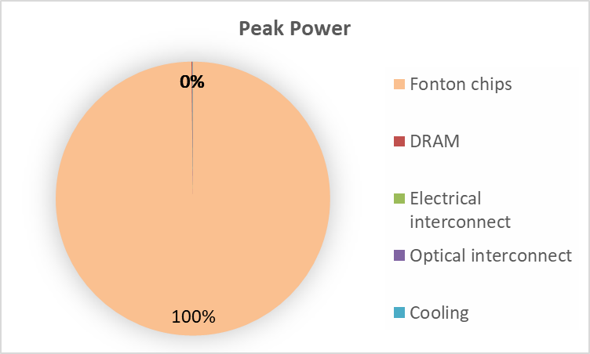

Power Requirements: Major Components
Component | Peak power [W] | Average power [W] | Coolant flow [l/s] (*)
Module | 121K | 7.3K | 0.18
Rack | 5M | 316K | 7.6
System | 122M | 7.6M | 181
* For water based coolant and ΔT=10K measured between module inlet and outlet

Slide 28
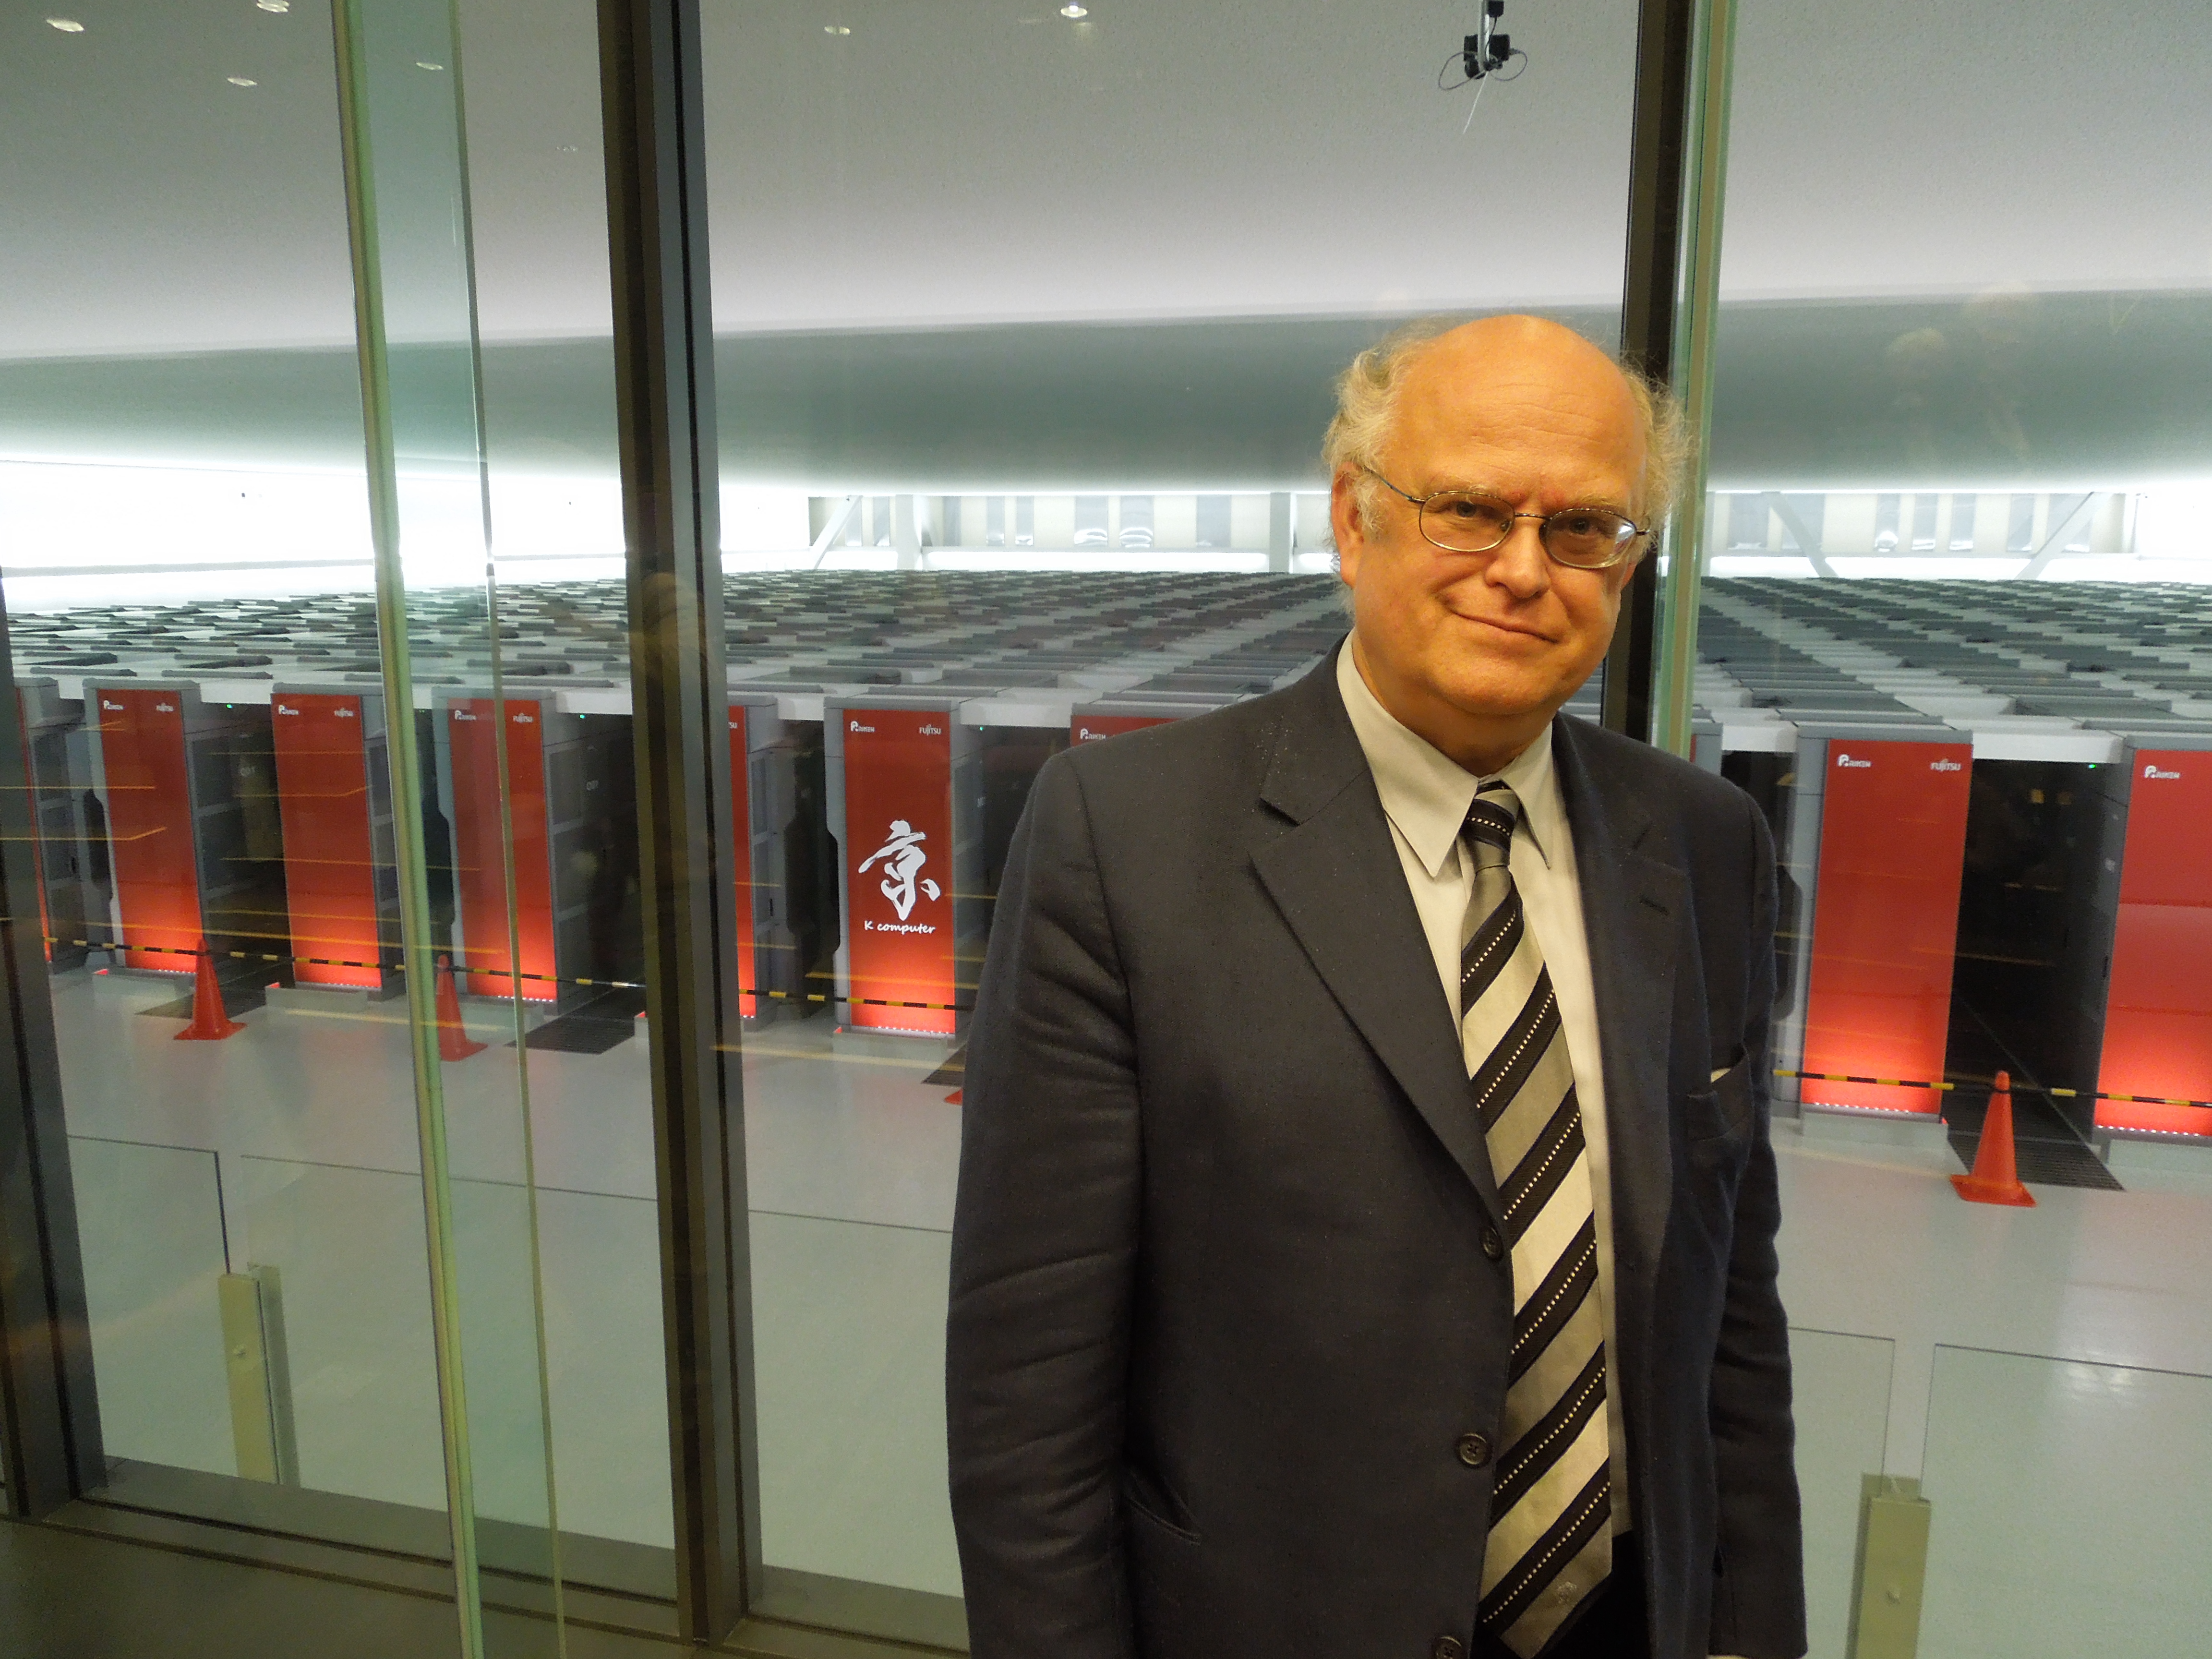
Graph-500 BFS Benchmark
Japanese K Computer #1 on benchmark
  5500 square feet foot-print
  12.7 Megawatts power consumption
Continuum Computer Architecture-based system
  Achieves the same level of performance on the benchmark
    According to the Graph-500 rules
    Same algorithm including barriers
  12 square feet foot-print (single half-height rack)
  37 Kilowatts
Caveats
  Simulated
  Different memory capacities (still legal by the rules)
  Random access data placement in assumed CCA
  Doesn’t exploit CCA asynchronous fine-grain parallel control

Slide 29
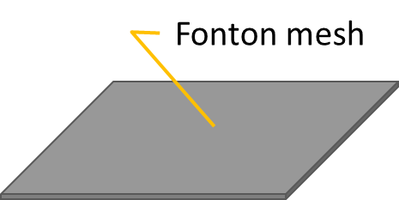
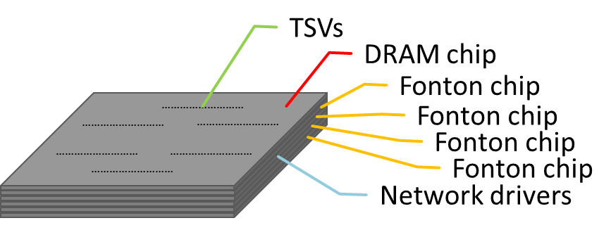
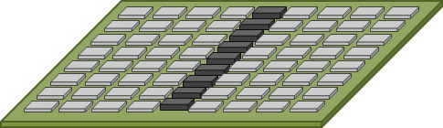
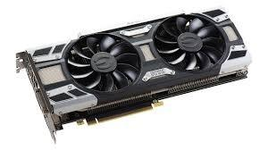
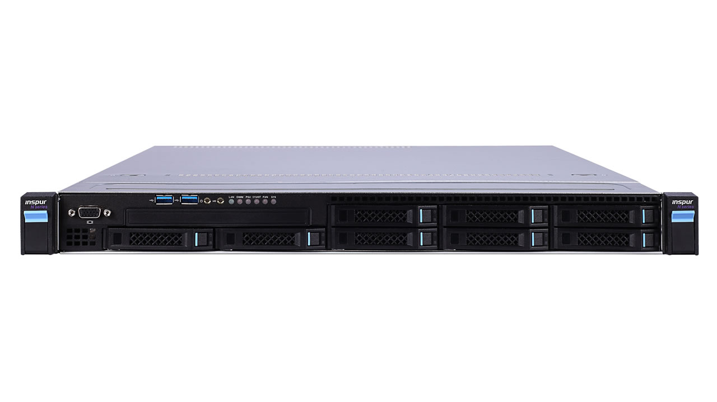
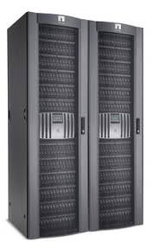
System Scaling
Chip
Socket
  Unstacked
  Stacked
Board
  Accelerator I
Module
  Accelerator II
Rack
System

Slide 30
Assumptions
Simplicity of design
  RTL definition should not require more than a few EEs
  Same for testing (mostly automated)
  Initial implementation fits in an FPGA
Implementable using existing technology
  Fabrication process node
  Interconnect networks
  Enclosures and cooling
  Preference for COTS components for secondary functions
Conservative estimate of capabilities and power
Development skill-building concurrent with growth of hardware capabilities (affects roadmap)
CCA Co-designed with ParalleX guiding execution model
It has to make sense at every stage: be responsible and eliminate naïve approaches
Its about the Graphs

Slide 31
Factors of Gain Beyond Exascale
Foot-print: x2 in width, x2 in height
  5 rows of 20 racks
  Approx. 1200 square feet
Clock rate: to 500 MHz gives x2, x2
Multivariate Logic: to base-4 yielding x2
Chip density: 16 nm → 8 nm yielding x2L & x2W
Socket stacking: double dies provides x2
  8 fonton dies stacked with DRAM die and communication die
Double chip linear size: x1.5
  2 cm x 2 cm
4-way ILP: x2, x2
Result: Zetaflops peak performance

Slide 32
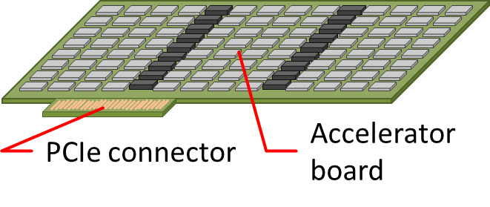
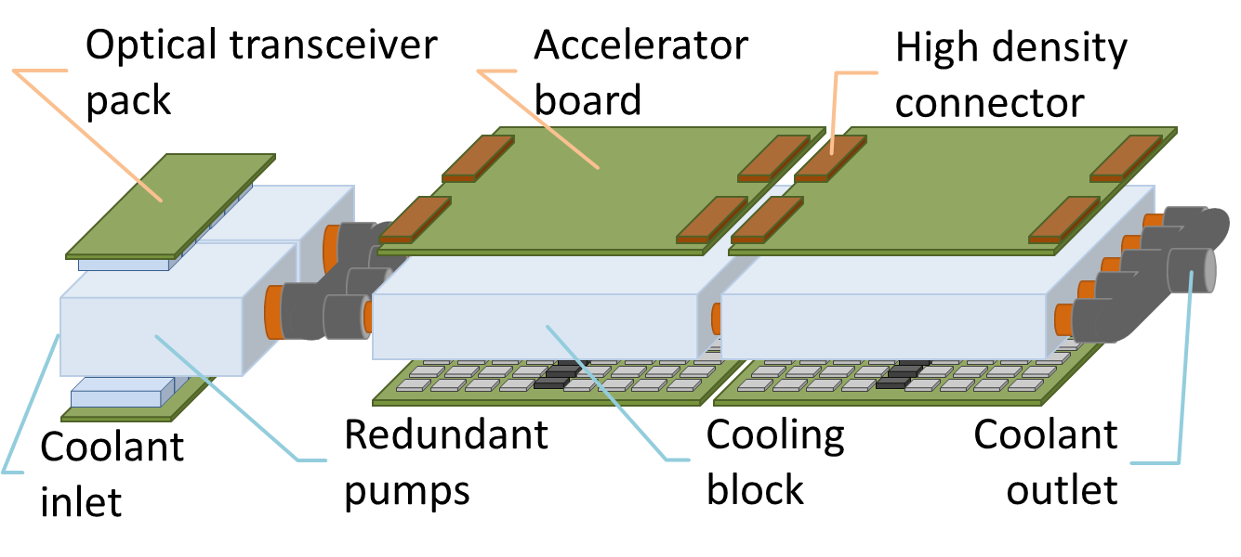
Memory Accelerator
GPU form factor
  >100 Tops peak
  PCIe connectivity
  Unstacked chips
  Discrete DRAM
  Air-cooled
Standalone module
  1 Petaflops peak
  1U rackmount
  Stacked chips
  Active liquid cooling

Slide 33
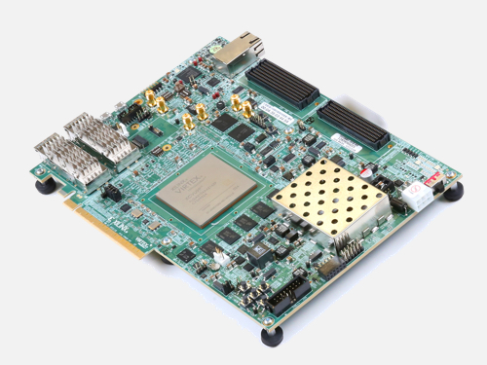

Technology Roadmap
Software simulator
Early prototype in FPGA
Proof-of-concept silicon via MOSIS Educational Program
Package options exploration for both jig and testbed
Test jig PCB design, fabrication, and population
Testbed chips via MOSIS Multi-Project Wafer
Testbed PCB design, fabrication, and population
Stacked chips for high-performance capability
Accelerator boards design, fabrication, and population
Module design, fabrication, and assembly for accelerator
Multi-module systems and interconnect

Slide 34
CCA SYSTEM ROADMAP
DELIVERY | MILESTONE | PEAK PERFORMANCE | FOOTPRINT AREA | SYSTEM FORM
Jan-18 | Start |  |  | HPX+ and CCA concept co-design planning
Feb-18 | Initial computing cell architecture
Dec-18 | V1.0 Architecture/FPGA implemenetation | 16 Megaflops |  | C-Cells on FPGA
Sep-19 | Computing Cell MOSIS test die and jig | 2 Gigaflops |  | 100 C-Cells on chip
May-20 | Test die | 128 Gigaflops |  | Chip on PC-jig
Oct-20 | Testbed | 104 Teraflops |  | 2 boards x 416 chips on PC-board
Sep-21 | Pluggable/Embedded accelerator | 32 Teraflops |  | PCIe installed
 | Module/Stacked chips and liquid cooling/External accelerator | 1 Petaflops (2 ⁵⁰) |  | Full Simultac module 4 boards, stacked dies, 160 MHz
Sep-22 | 1 Exaflops | 1 Exaflops |  | 32 modules x 24 racks cylinder configuration, Kautz global network

Slide 35
Conclusions
The race for exascale has blinded us to potential opportunities across the trans-exaflops performance regime and more
The frontiers of supercomputing expand by x10⁶ in14 years
von Neumann architecture assumptions barriers to progress
Continuum Computer Architecture is fine-grained structure
ParalleX execution model abstractions for programming and global parallel control
Looking forward: a revolution in HPC better than the past

Slide 36
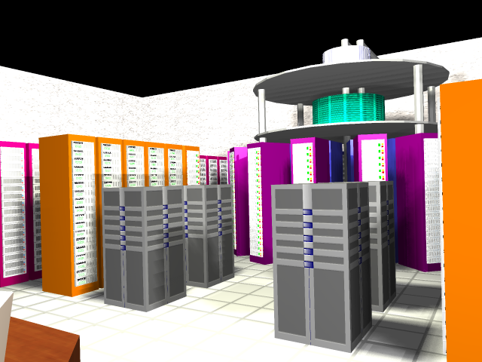
Epilog – Yotta-flops Superconducting CCA
Cryogenic Nb logic
  Based on squid component
  2 Josephson-Junctions (JJ)
  Explored by HTMT project
  Cooled to 4 K, liquid helium
    X100 efficiency
Clock rate: 200 Giga-Hertz
  Best achieved: 740 GHz
Intrinsic multivariate capability
  Quantum effect
Propagation delay ~mm/cycle
  Favors
Need x2.5 optimizations (ILP?)
Cryo-memory required
Nanoscale feature size needed
Result: ~ 1 Yottaflops peak

Slide 37




