Slide 1
Introduction to iRODS Data Grids and Policy-Driven Data Management with iRODS
Leesa Brieger

Slide 2
Data Intensive Cyber Environments (DICE Group)
Developers of iRODS
Directed by Reagan Moore
Joint appointment at University of North Carolina (UNC): at RENCI and at the School of Information and Library Science (SILS)
Developed SRB, the Storage Resource Broker
Began at SDSC, the San Diego Supercomputer Center
Most of the group migrated to UNC Chapel Hill in 2008-2009
The group is bi-coastal: DICE-UNC, DICE-UCSD
Released iRODS, the integrated Rule-Oriented Data System, in 2009

Slide 3
RENCI
A research unit of UNC Chapel Hill
State-supported
Governed by the Triangle universities:
University of North Carolina at Chapel Hill
NC State University (Raleigh)
Duke University (Durham)
Works on sustainable software development (best practices)
Now supporting iRODS with development of Enterprise iRODS

Slide 4
iRODS Evolution
Based on decade-long SRB development experience for managing distributed data
Community-driven
iRODS picked up where SRB left off
Modular, extensible, customizable
Open source (BSD license)
Supported at UNC by DICE and RENCI
DICE: iRODS
RENCI: Enterprise iRODS (E-iRODS)

Slide 5
iRODS
Data grid middleware
Data management infrastructure
A framework for procedural implementation of data management policy (policy-driven data management)
iRODS is all these.

Slide 6
I. iRODS as Data Grid Middleware

Slide 7
iRODS Unified Virtual Collection
iRODS View of Distributed Data
User Client
User sees a single collection
My Data:
disk, filesystem,
site-specific storage, ...
My Data:
tape, database, filesystem, ...
Partner’s Data
remote disk, tape, filesystem, site-specific storage,…
iRODS installs over heterogeneous data resources
Users can share & manage distributed data as a single collection

Slide 8
iRODS as a Data Grid
Sharing data across:
geographic and institutional boundaries
heterogeneous resources (hardware/software)
Virtual (logical) collections of distributed data
Global name spaces
data: files and collections
users: single sign on
storage: virtual resources
Supporting a multi-site repository model
Metadata catalogue (iCAT) manages mappings between logical and physical name spaces
Notes:
Users:
single sign-on to reach data distributed among many sites
no unix accounts required to access distributed data (the data grid manages its users’ authorization)

Slide 9
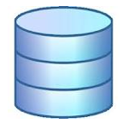
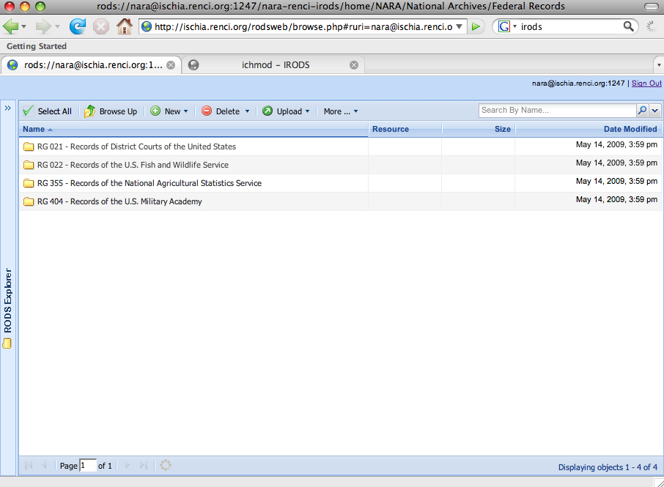
A RENCI Data Grid
A complete data grid (zone) has
one metadata catalogue (iCAT)
Duke
NCSU
iRODS Server
iRODS Server
ECU
UNC-A
UNC-CH
RENCI, Europa Center
iRODS Server
iRODS Server
Metadata Catalog (iCAT)
iRODS Server
iRODS Server
Client asks for data – request goes to an iRODS server
Server contacts the iCAT-enabled server
Information (location, access rights, etc) is
retrieved from the iCAT
Server containing data is signaled to send data to
authorized client

Slide 10
TUCASI Infrastructure Project (TIP)
Federated Data Grids
Independent data grids (zones),
each with its own iCAT,
can be federated

Slide 11
II. iRODS for Data Management

Slide 12
Issues in Data Management
Organization and Usage
Distributed data/virtual collections
Distributed access to data (groups); data sharing (remote access and permissions/protection)
Publishing (general distribution)
Back-ups and replicas
Metadata collection and tagging
Evolution in usage model (life cycle)

Slide 13
Data Life Cycle
Creation
Active Use
Publication & Sharing
Local Policy
Reference Collection
Service/Use
Distribution
Archival Collection/Deletion
Discovery and
Re-purposing
Retention/
Preservation
Usage evolution across the stages of the data life cycle.
s ds

Slide 14
More Issues in Data Management
Requirements on Data Infrastructure
Data integrity, authenticity/verification, provenance
Discoverability (metadata management and query support)
Audit tracking/accounting
Reanalysis, reproducibility
Interfaces to the data
Data services (derived products, new formats,…)

Slide 15
Further Considerations (From the archivists)
Ingestion
How will data be submitted?
Virus checks
Data types
Necessary metadata
Sharing
Access rights
Copyright and intellectual property terms
Curation
Setting policy requirements into action – implementation
Managing remote data
Preservation
Long-term: life span, archival policy
Metadata to support policy

Slide 16
iRODS for Data Management
Need an overall data management plan in order to define data strategies.
Clear statement of data
management plan
iRODS can be used to procedurally implement that data policy.
= data policy

Slide 17
III. iRODS for Policy-Driven Data Management

Slide 18
What is Policy-Driven Data Management?
Policy determines when management procedures are run
Define a data policy
Identify the management steps to carry out the policy
Define computer procedures for implementation
Trigger the procedures when policy requires
Events in the data grid such as
putting, getting, and replicating collections or files
creating users, resources, groups
can trigger procedures.
State of the data grid can trigger procedures
when a given time period has elapsed
whenever a file of prescribed format is ingested
when data reaches a prescribed age
sdfsdf

Slide 19
Policy-Oriented Data Infrastructure Additional Components & Goals
Implement management policies
Each community defines its own policies
Manage administrative tasks
Data administrator or data proprietor (not system administrator) manages data collections
Assessment criteria for checking policy compliance
Point-in-time: queries on metadata catalog
Compliance over time: queries on audit tables

Slide 20
Additional iRODS Design Goals
Abstract out the data management
Separate policy enforcement from storage administration
Policy follows data around the grid: collection management independent of remote storage locations
Scalability and extensibility
Enable versioning of policies and procedures and data [planned]
Support differentiated services (storage, metadata, messaging, workflow, scheduling)
Pluggable microservice & driver modules [coming and planned]
Notes:
This is the first mention of microservices… defined in the next slide.

Slide 21
iRODS Policy Implementation Microservices and Rules
Microservice – the functional unit of work (C programs)
Rules – workflows of microservices (and rules)
Provide server-side (data-side) services
Event-triggered rule execution
New libraries of microservices (modules) can be developed without touching the core code
Allow customization and extension of the data grid for community-specific policy

Slide 22
iRODS Data Virtualization
Access Interface
Map from client requests to multiple policy enforcement points (trigger points).
Map from policy to standard microservices.
Map from microservices to standard Posix
I/O operations.
Map standard I/O operations to the protocol supported by the storage system
Policy Enforcement Points
Standard Microservices
iRODS layer
Standard I/O Operations
Storage Protocol
Storage System
Asdfadsfasd
afsdfasdfsdf

Slide 23
Server Functions
Translate from client action to storage protocol
Peer-to-peer architecture
iCAT-enabled server (IES) interacts with metadata catalog
authorized requests are forwarded to server where data reside
Authenticate and authorize requested operations
Implement/enforce policies from local rule engine
Manage execution of processes at the storage location

Slide 24
An iRODS Overview

Slide 25
Highly Controlled Environment
All accesses are authenticated
GSI / Kerberos / Challenge-response / Shibboleth
Additional mechanisms in development (PAM)
Only authorized operations are allowed
ACLs on files, storage
Constraints on each rule (only authorized users can run them)
Local rule base controls interactions with local storage

Slide 26
Some Management Capabilities
Replication
Registration of files into the data grid
Synchronization of remote directory
Managed file transport (iDrop)
Automated metadata extraction
Queries on metadata, tags
Server-side workflows (loop over result sets)
Parallel I/O streams & RBUDP (Reliable Blast UDP) transport

Slide 27
The iDrop Suite
iDrop Web – browser client
iDrop Lite – a servlet that uses tcp/ip rather than http transport protocol – used for large file transfer
iDrop Desktop – GUI presentation of a desktop client with logging and restart capabilities for transfers

Slide 28
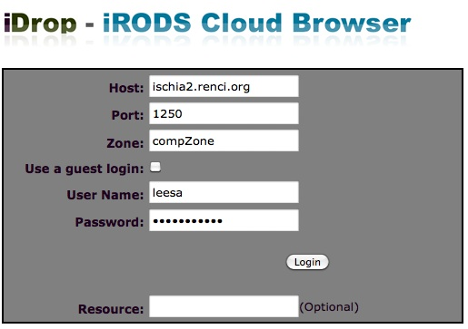
iDrop Web
Can use http://iren-web.renci.org:8080/idrop-web for testing
Enter iRODS environment variables
Login in to any
data grid
This instance is
not secure
iDrop Web is a
work in progress
Alternative login:
Host:
irods00.lab.nsc.liu.se
Port: 1260
Zone: snicZone

Slide 29
iDrop Web
Browsing
Upload/download
Audit trail
Tickets
Can create an “anonymous” link to any file to allow any user access through iDrop Web

Slide 30
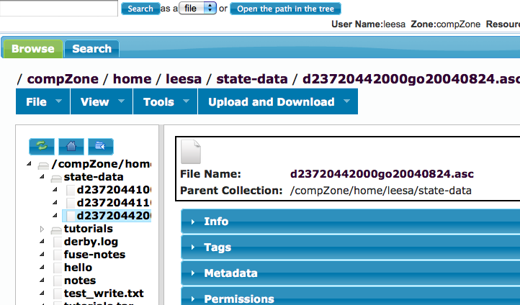
iDrop Web
Browse, add/modify metadata, upload/download data, change ACL permissions, …
Generate a url to a data object (file): Select Tools > Create public link

Slide 31
Grant access to the file with this url
iDrop Web – generating a url to a file

Slide 32
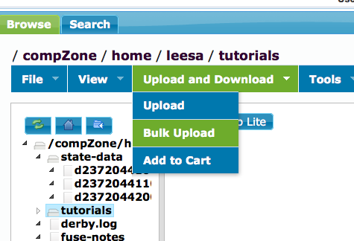
Bulk upload – iDrop Lite for uploads
Select a collection
For large files, launch iDrop Lite, which uses a different transport protocol: Select Upload and Download > Bulk Upload

Slide 33
iDrop Lite – bulk upload
Choose a local file or directory to upload into iRODS collection

Slide 34
iDrop Lite Transfer

Slide 35
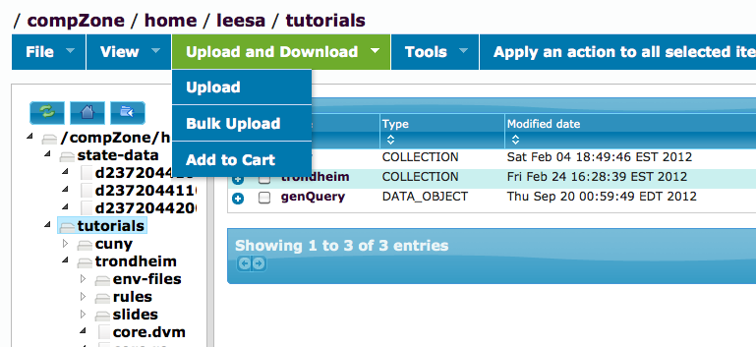
File cart – iDrop Lite for downloads
Select a file or collection
Add to Cart

Slide 36
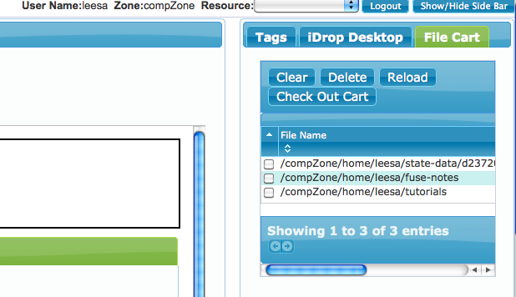
iDrop Web Sidebar – File Cart
Select Show Side Bar (far upper right corner)
Select File Cart – select multiple files for group upload
Select Check Out Cart to initiate transfer

Slide 37
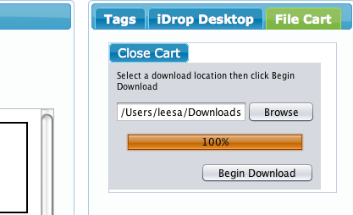
File Cart Download
Browse to select a local location for download
Begin download

Slide 38
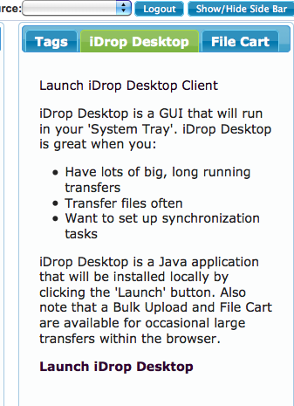
iDrop Desktop – managed transfers
iDrop Web Sidebar
Launch iDrop Desktop

Slide 39
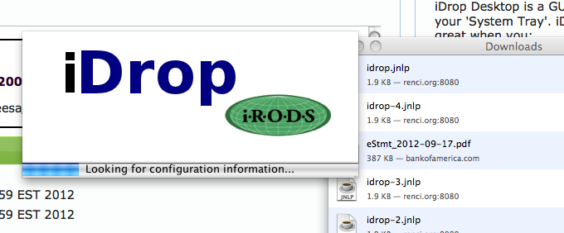
Launch iDrop Desktop
Downloads idrop-jnlp and launches

Slide 40
iDrop Desktop Login

Slide 41
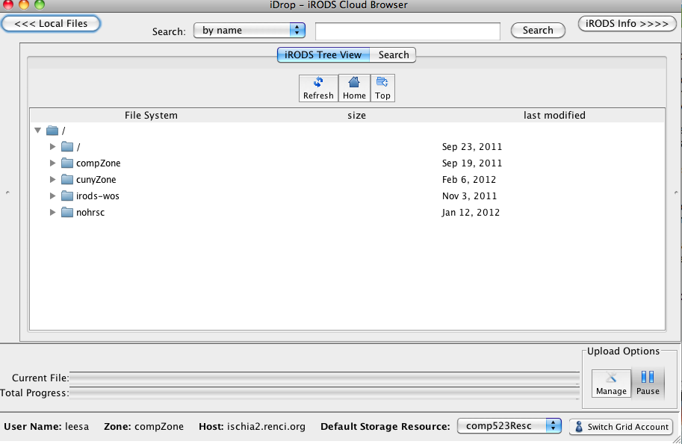
iDrop Desktop
Starts out at the root directory

Slide 42
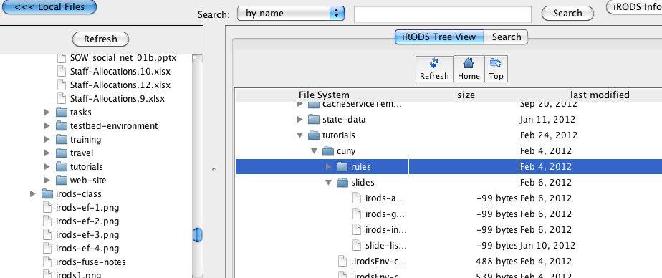
iDrop Desktop – drag and drop
Select Local Files at top left to open local file tree
Drag and drop to transfer files between iRODS and local file system (both directions)

Slide 43
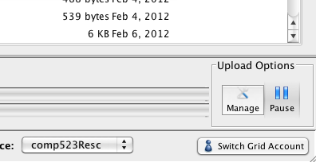
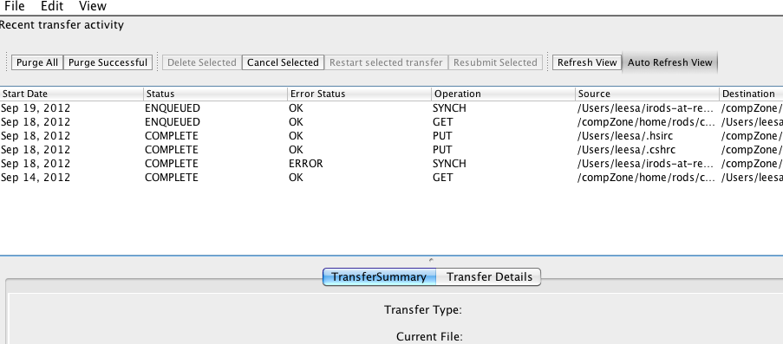
iDrop Transfer Manager
Lower right Manage button
to see the transfer manager
This opens the transfer manager
See log of the past, current,
and pending transfers

Slide 44
Setting Up iDrop Web Server
Download from https://code.renci.org/gf/project/irodsidrop/
Grails to build the application; this generate a war file
Need a servlet container, such as Tomcat, to deploy and run
A package installer is coming: deb, rpm
Based on Jargon
It is said that the trickiest part about setting this up is making sure that your firewall allows incoming connections.
Contacts: Mike Conway (michael_conway@unc.edu) and
Lisa Stillwell (lisa@renci.org)

Slide 45
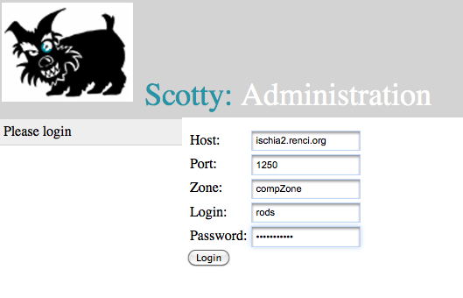
iRODS Admin GUI and Monitoring App
http://iren-web.renci.org:8080/Scotty/faces/login.xhtml to login to any data grid (where you are an admin)

Slide 46
Scotty: Administration

Slide 47
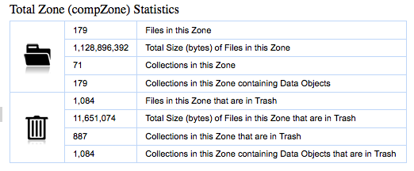
Scotty: Administration
Currently collects statistics on the iRODS data grid
Zone: number files, cumulative size of file, number collections, etc
Per user: number files, cumulative size of file, number collections, etc
Per resource: …

Slide 48
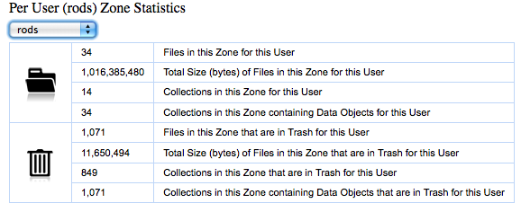
Scotty: Administration
Planned: will use Pyrods to acquire information about the system and pass that to iRODS for presentation by the Scotty admin page

Slide 49
iRODS Version 3.2
Draft Release Notes at
https://www.irods.org/index.php/Release_Notes_3.2
New features
MicroService Structured Objects (MSSO) – for rules
PAM/LDAP authentication - Pluggable Authentication Modules
Additional netcdf development – services
Direct Access Resources – users’ directories get picked up into iRODS
File system metadata – stat a file that gets put into iRODS, store the info in a new table in the iCAT
Rule language support of genQuery syntax – a rule rather than a microservice
Optional use of a system-installed PostgreSQL/ODBC - supported now by the irodssetup script
ils –A groups not expanded – requires setting up a specific query

Slide 50
iRODS Books
The integrated Rule-Oriented Data System (iRODS) Microservice Workbook
Available from Amazon: http://www.amazon.com/dp/1466469129
Describes rule language
Lists examples for using the current microservices
iRODS Primer: integrated Rule-Oriented Data System (Synthesis Lectures on Information Concepts, Retrieval, and Services)
From Amazon at http://www.amazon.com/dp/1608453332

Slide 51
Enterprise iRODS: E-iRODS
RENCI’s and UNC’s long-term support for iRODS
Target new funding models
Diversify funding sources for better sustainability
Develop in directions that research funding does not encourage: software engineering, usability, packaging, more complete documentation
Beta 2 release based on iRODS 3.0 out in June 2012 at e-irods.org
Organization:
Research code (DICE) released about every 4 months
Enterprise code (RENCI) released about every 18 months
Service agreements and consulting negotiable
E-iRODS Consortium to fund Enterprise support infrastructure

Slide 52
E-iRODS Consortium
Membership dues will fund basic E-iRODS development; research funding will keep iRODS development going
E-iRODS remains completely open source (binary and source code)
The Consortium will gather together organizations who depend on the longevity of the iRODS technology, allowing them input and coordination on the roadmap
Membership levels
Affiliate
Access to release roadmap
Privileged access to (paid) consulting and technical support
Professional
Voting rights to release roadmap
Non-voting seat on governing board
Sustaining
Voting seat on governing board
In negotiating
phase now;
looking to
get consensus
from
prospective
partners on
by-laws and
memberships.
asdfasdfasfasdfasf

Slide 53
Yearly iRODS User Meetings
2011 Meeting
February 2011
Chapel Hill, NC
Organized by the DICE group, hosted by RENCI
2012 Meeting
March 1, 2
Tucson, Arizona
Organized by the DICE group, hosted by the iPlant consortium
National and international participation by many in the iRODS user community
2013 Meeting (tentatively)
Feb - March 2013
University of Cologne

Slide 54
Birds of a Feather iRODS Session at SC12
Scheduled for Wednesday evening 7-9pm
Discussion of iRODS, E-iRODS, the E-iRODS Consortium
Co-hosted with Reagan Moore
Panel includes representatives from
NASA
the Max Planck Society
the Broad Institute of MIT and Harvard (genomics)
Not part of the official SC12 program, but we’ll have announcement and postcards with details at the RENCI booth

