Slide 1
Authentication and Authorization in a federated environment Jules Wolfrat (SARA)

Slide 2
Overview
Introduction
Federation initiatives
Trust building
PRACE federation
2

Slide 3
Introduction
Authentication and Authorisation are different activities but highly related, so can be confusing
Identity mgmt is basis for authentication
Access mgmt is separate but depends on the identity mgmt
Different technologies: LDAP, Kerberos, GSI (X.509), SAML, etc.

Slide 4
Identity Provider (IdP)
Provides electronic information about an entity (user)
Can be anything: employer, state (electronic id card), science community, infrastructure
Information is released based on authentication by user and/or service
Authentication based on: login/password, e-tokens (SecureId, X.509, Kerberos, SAML assertion)
Difference between IdPs and AAs (Attribute Authorities) but basically both release information about an entity
AA used for authorisation

Slide 5
Federated IdPs
Identity Provider (IdP)
IdP
IdP
Discovery Service
Token (3)
WAYF
(2)
(1)
User
(4)
Service
Service examples: eduroam, TCS, ….

Slide 6
Federation of IdPs
Enables sharing of attributes (e-mail address, telephone number, organisation, etc.)
Single Sign-On (SSO), based on single IdP, e.g. your organisation
For sharing of data in different domains
Merging of information may be needed
For authorisation, e.g. for access to PRACE system authentication by your organisation won’t be enough
Example: VOMS service will add additional information to your proxy certificate
Problem of different formats

Slide 7
FIM for research collaborations (FIM4R)
Issue of IdM raised by IT leaders from EIROforum labs (Jan 2011)
CERN, EFDA-JET, EMBL, ESA, ESO, ESRF, European XFEL and ILL
These laboratories, as well as national and regional research organizations, are facing similar challenges
Scientific data deluge means massive quantities of data
needs to be accessed by expanding user bases in dynamic collaborations across organisational and national boundaries
“Facebook” generation demands all the tools (work & social) integrate smoothly
Also encouraged by EEF and eIRG
Global problem, not just EU

Slide 8
FIM4R (2)
A collaborative effort started in June 2011
Not just EIROForum. includes many ESFRI projects and providers and infrastructures (including PRACE)
Involves photon & neutron facilities, social science & humanities, high energy physics, climate science, life sciences and fusion energy
Workshops included participation by HTC and HPC infrastructures, TERENA, IGTF, Geant/eduGAIN, middleware developers …

Slide 9
FIM4R (3)
Four workshops held with representatives of research communities and infrastructures
4th: https://indico.cern.ch/conferenceDisplay.py?confId=191892
Paper produced with requirements and recommendations:
Federated Identity Management for Research Collaborations
https://cdsweb.cern.ch/record/1442597

Slide 10
FIM4R vision statement
A common policy and trust framework for Identity
Management based on existing structures and
federations either presently in use by or available to
the communities. This framework must provide
researchers with unique electronic identities
authenticated in multiple administrative domains
and across national boundaries that can be used
together with community defined attributes to
authorize access to digital resources

Slide 11
Federation requirements
User friendliness
Many users use infrequently
Browser and non-browser federated access
Bridging between communities
Multiple technologies and translators
Translation will often need to be dynamic
Open standards and sustainable licenses
For interoperability and sustainability
Different Levels of Assurance
When credentials are translated, LoA provenance to be preserved
Authorisation under community and/or facility control
Externally managed IdPs cannot fulfil this role

Slide 12
Federation requirements (2)
Well defined semantically harmonised attributes
For interoperable authorisation
Likely to be very difficult to achieve!
Flexible and scalable IdP attribute release policy
Different communities and different SPs need different attributes
Negotiate with IdF not all IdPs – for scaling
Attributes must be able to cross national borders
Data protection/privacy considerations
Attribute aggregation for authorisation
Privacy and data protection to be addressed with communitywide individual identities
We need to identify individuals
E.g. ethical committees can require names, addresses, supervisors to grant access

Slide 13
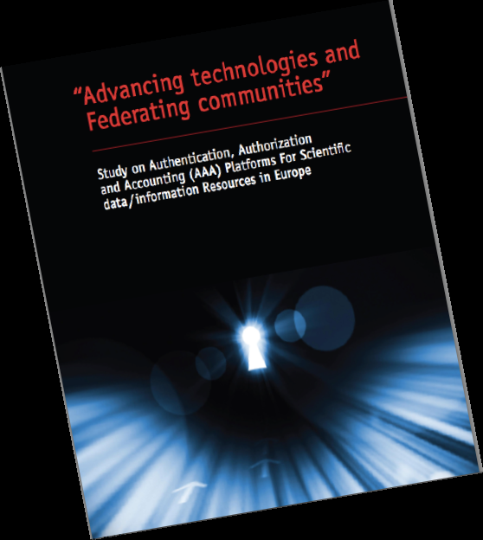
Study on AAA Platforms For Scientific data/information Resources in Europe
Project by consortium of four partners, led by TERENA, funded by EU.
Report published:
https://confluence.terena.org/download/attachments/30474266/AAA-Study-Report-0907.pdf?version=1&modificationDate=1341850616400
The goal of this study, prepared for the European Commission, is to evaluate the feasibility of delivering an integrated AAI, to help the emergence of a robust platform for access and preservation of scientific information within a Scientific Data Infrastructure (SDI).

Slide 14
Trust building
Trust needed between IdPs/federations and service providers
LoA for provided data
IGTF for policy management authorities for trusted Certificate Authorities
Privacy requirements must be respected by SPs
TERENA/GEANT produced a Code of Conduct document. https://refeds.terena.org/images/4/45/GN3-12-215_GEANT_Data_Protection_Code_of_Conduct_21Jun2012.pdf
Signed by an SP it should enable the release of attributes by IdPs
No need of individual contracts.

Slide 15
The ESFRI Vision for a European HPC service
European HPC-facilities at the top of
an HPC provisioning pyramid
Tier-0: 3-6 European Centres for Petaflop
Tier-0: ? European Centres for Exaflop
Tier-1: National Centres
Tier-2: Regional/University Centres
Creation of a European HPC
ecosystem
Scientific and industrial user communities
HPC service providers on all tiers
Grid Infrastructures
The European HPC hard- and software industry
PRACE
Tier-0
DEISA/PRACE
capability
Tier-1
Tier-2
# of systems

Slide 16
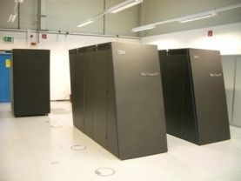
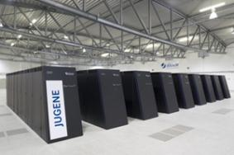
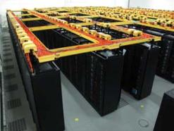
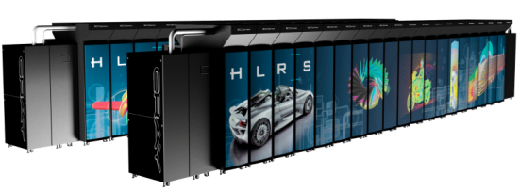
Tier-0/Tier-1 infrastructure
Tier-0: All > Pflops. 4 are in the top 10 of the June Top500 list
Tier-0
Tier-1 infrastructure
22 sites by the end of 2012

Slide 17
PRACE federation
User attributes are shared using LDAP facilities
Based on trust between partners
Operational procedures are documented in AAA administration guide
All partners have access to the data
Advantage is easy to add or adapt attributes (e.g. new values).
SSO based on X.509 certificates, using IGTF as trust basis

Slide 18
There is still some work to be done

Slide 19
References
Fourth workshop on Federated Identity Management for Scientific Collaborations (FIM4R)
https://indico.cern.ch/conferenceDisplay.py?confId=191892
Vision document: https://cdsweb.cern.ch/record/1442597
TERENA workshop on AAA study
https://confluence.terena.org/display/aaastudy/AAA+Study+Workshop
report: https://confluence.terena.org/download/attachments/30474266/AAA-Study-Report-0907.pdf?version=1&modificationDate=1341850616400

